Slide 1

Agency Roles and Responsibilities for SFS Administration
Internal Control Officer Resources
For use with New York State agency staff
1 and SFS users. Contents subject to change.
3/23/2017
Notes:
Roger Aucoin

Slide 2
Agenda
Objectives
ICO Role & Responsibilities
Coordination with Administrators
ICO Resources
Questions

Slide 3
Objectives
Provide an overview of SFS areas where internal control monitoring is critical for success and data protection
Know where to go for resources and tools to assist Internal Control Officers

Slide 4
Internal Controls
Internal Controls over Security access relates to the OSC Advisory 28 and the Certification of Internal Controls over the Payment Process.
The recent updates to the SFS Security policy, the recent Internal Control Officer training, and the new Internal Control Officer resource page are meant to help Agencies more easily achieve the goals outlined in the OSC advisory and certification.

Slide 5
SFS Security Policy
Each Agency works to comply with OSC Advisory 28 and the related Certification requirements. The SFS Security policy referenced in the Certification is stored on SFS Secure.
  Starting on page 11 of the SFS Security Policy, the roles and responsibilities of the Agency Security Administrator (ASA) are explained.
  Starting on page 13 of the SFS Security Policy, the roles and responsibilities of the Agency Internal Control Officer (ICO) are explained.

Slide 6
ICO Role & Responsibilities
Kristen Pelcher
|| ₆
Statewide Financial System (Internal Use Only).
9 Contents subject to change.
3/23/2017
Statewide Financial System (Internal Use Only).
Contents subject to change.
Notes:
Kristen

Slide 7
ICO SFS Responsibilities
Understand potential SFS risk scenarios for your agency and available tools to monitor data integrity
Validate that your agency business processes reflect:
  The communication required to keep SFS data up to date
  The ongoing internal control monitoring of data maintenance
Confirm with your ASA that you have the appropriate data access to view agency administrator queries
Upon finding a gap in SFS data maintenance, update internal agency business processes accordingly
Note: ICOs are not responsible for maintaining SFS data; ICOs are responsible for periodically monitoring that SFS data is being maintained appropriately.
Notes:
Kristen

Slide 8
Monitoring Explained
Monitoring should include an internal agency review to ensure that you
have the below processes documented:
HR office communication procedure as it relates to:
  SFS account creation for Employee Onboarding
  SFS account locking/removal for Employee Separation
  SFS account changes for both Employee Internal and External Transfers.
Supervisory checklist for new or changed SFS users to receive training
Regular review and associated SFS sign off submission for:
  SFS Quarterly access reports & Administrator activities
  OSC Advisory 28 Guideline Alignment and ICO Certification of Payables

Slide 9
SFS Security Policy – Key ICO Item
ICO View Role Request Process
Agency Head/Chief Financial Officer should follow the Agency internal process to request the ICO View role be assigned in SFS to the Internal Control Officer.
Recommended Action for Compliance
  All Internal Control Officers and any internal auditors responsible for monitoring Agency Administrator activity should have SFS access and have the Internal Control Officer View role assigned.

Slide 10
SFS Security Policy – Key ICO Item
Quarterly Review
Quarterly review and yearly return of periodic user access and role assignment audits.
Recommended Actions for Compliance
Document an agency process around their monitoring procedures that ensures a Quarterly review, and that:
  The Agency is returning the requested SFS Quarterly sign
off form at least once each fiscal year in July.
  Those who sign are checking the boxes on the form based on the monitoring performed.
  If not receiving the email, confirm ICO designation form has been submitted on your behalf
Notes:
Follow-up in October for those agencies that haven’t responded

Slide 11

SFS Quarterly Reports
SFS delivers provisioned access reports, once per quarter, in April, July,
October, and January, for review by ASAs, ICOs, and Agency Coordinators.
SFS requires agencies to validate and sign-off on their agency users and their role mapping in the SFS system at least once every fiscal year. This validation should ensure that only active users are maintained in New York State’s enterprise Financial System. As part of OSC’s Annual Financial Audit over SFS, responses provided by each agency are reviewed and are subject to audit.
Failure to submit an annual sign off will result in an escalation to the Agency
CFO and if necessary, the Agency Head.
  If no sign off submission is received after this escalation, the SFS Joint Governance Board (JGB) will be notified of the non-compliance with Internal Controls Standards
At the time of the October quarterly report distribution, SFS Security will reach out to all non-compliant agencies to ensure that they have time to act on the yearly sign off requirement.
₁₁
For use with New York State agency staff and SFS users. Contents subject to change.

Slide 12
Quarterly Reports and Validation
Pay attention to the SFS Quarterly Reports (distributed from SFS Security to ICOs, ASAs, and Agency Coordinators).
Incorporate the available data integrity queries into your annual Internal
Controls review.
  Job Aid: JAA-EDA205-008 Maintaining Data Integrity Using Queries
  NOTE: These real-time queries are available to Administrators in the SFS year- round.
It is recommended that multiple signatures (ASA, ICO, and Agency Coordinator) be provided on the Quarterly validation.

Slide 13
Quarterly Report Sign Off
Submission Observations
  Sometimes agencies are checking all the attestation boxes
    As the statements contradict each other, you should only be checking
to align with the activities you have performed.
    It is important to read what you are attesting to, as these forms are subject to audit.
    In addition to checking the boxes, your agency should retain proof of monitoring activities such as periodic report results and evidence of follow ups.
  Some agencies are not returning forms timely
    If we don’t receive a timely response, your agency’s lack of a response is escalated to our Leadership, and then to the Joint Governance Board of SFS.

Slide 14

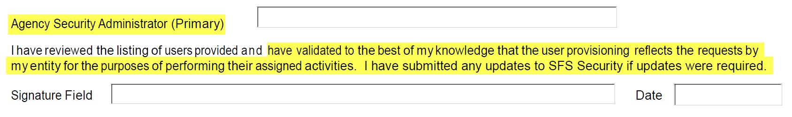

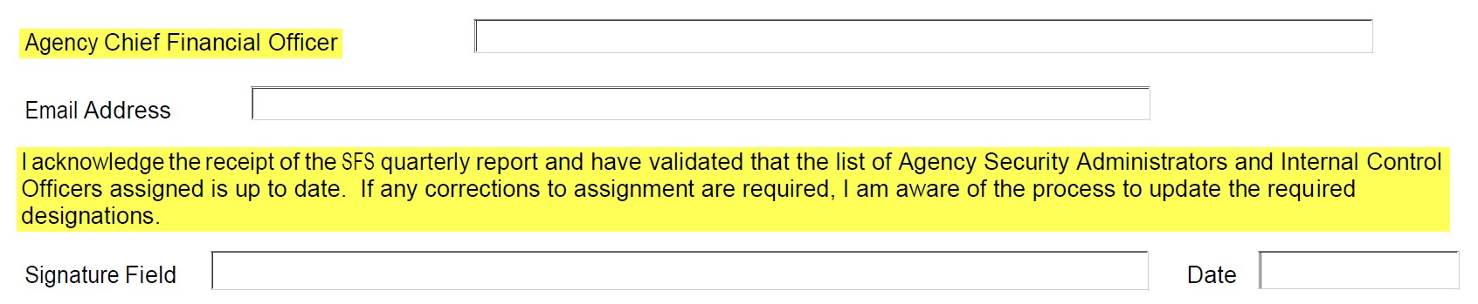
Quarterly Report Sign Off
ASA signs off, attesting that they processed requests based on approved Agency requests,
per the Agencies internal business process.
CFO signs off, attesting that they have validated that ASA designations and ICO designations are up to date, and if not, that they are in the process of sending to SFS any required updates.

Slide 15

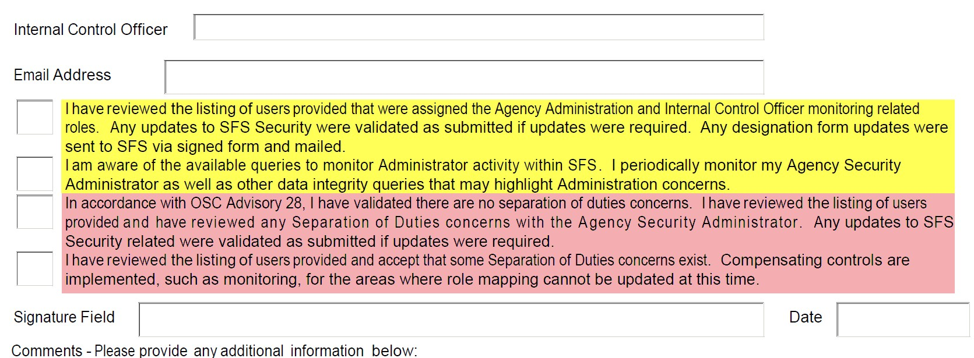
Quarterly Report Sign Off
ICO’s need to attest to their awareness of best practices, and that they are monitoring periodically.
These forms are subject to audit and evidence of monitoring may be requested of you.
Due diligence is needed to ensure that internal controls are in place via SFS role mapping and any external compensating controls where applicable.

Slide 16
SFS Security Policy – Key ICO and ASA Items
Authorized Access and Accountability Maintenance
Ensure authorized access to data and resources, and that
authorized access accountability is assigned and maintained.
Recommended Actions for Compliance
Document an agency procedure that provides an audit trail on how
SFS Security access is granted, changed, and terminated.
SFS is currently drafting a recommended procedure.
Schedule periodic audits to ensure Administrator activities are appropriate.
  Internal auditors will randomly select ASA referenced activity from the ASA Activity query, and source the request back to the Agency internally documented procedure, to ensure the request was authorized.
Notes:
Any agency using SFS can be part of the OSC’s annual financial IT audit

Slide 17
Agency Internal Process Form
Agency approved SFS requests should align with Administrator activities generated through activity reporting.
Every request in SFS should be able to be mapped back to an authorized agency request on audit.
Request authorizations should be based on adherence to Separation of Duties best practices for internal controls.

Slide 18
Process Data Example
Approved Agency
ASA Request
EDA Updates
Monitoring Query
Request
Results
Effective Date
ASA Self
Supervisor
Effective date
ID Number
Ny.gov id
Service Request Number
changes
of changes align with authorized request
Department
Employee id
updates
Roles
ASA request
Audit Stamp
details for security changes
Account
on record
Roles on user
modifications
align with authorized request
locks/unlocks
Process Improvements are needed if:
Access is not updated at time of employee movement
  Account removal / locking requests should be sent at the time of user separation
New employees don’t have functioning accounts when they
start employment or change positions.
  Assigned roles should align timely with authorized requests to avoid separation of duties concerns.
Notes:
If ASA is not locking users on date of separation, then update internal processes for clearer line of communication of user movement.
If End Users are not receiving their SFS access timely, then update internal processes to allow for communication earlier in the process.

Slide 19
Coordination with
Administrators
Mary Alber
₁₉
Statewide Financial System (Internal Use Only).
37 Contents subject to change.
3/23/2017
Statewide Financial System (Internal Use Only).
Contents subject to change.

Slide 20
Agency Administrators
Within each Agency, there are several administrative and technical resources required to provide SFS user support.
Administrator | Description
Agency Security Administrator (ASA) | Controls assignment of system roles, have the ability to reset user passwords, lock and unlock user accounts, and report on employee data and role data within SFS.
Credit Card Administrator (CCA) | Assigns Procurement (P-Card) / NET / Travel (T-Card) credit cards to users and Reconcilers/Approvers to cards.
Employee Data Administrator (EDA) | Maintains employee data such as default Chartfield string values, travel supervisors, and requestor and buyer defaults (such as default BU and ship to information), and assigns travel proxies.
Workflow Administrator (WFA) | Understands and troubleshoots workflow; provides first-level support for transaction misroutes.
Password Reset and Unlock | Ability to unlock an employee’s SFS account, if the employee is locked out, lock an employee’s SFS account, and reset a password for an employee using the employee’s User ID.
SFS Agency Adminis
trators are the first-level of support for the SFS.

Slide 21
Administrator Coordination
Transaction Monitoring (WFA)
Security Request (ASA)
Internal Control Officer (ICO)
Credit Card Assignment (CCA)
Supervisor Update (EDA)
ICOs are at the center of administration monitoring in SFS, and need to be informed about ASA, WFA, EDA, and CCA duties, at each agency, to ensure appropriate coordination of activities, and enable successful use of the SFS.

Slide 22
Coordination between SFS Administrators
Risk: IF SFS Administrators (ASAs, CCAs, EDAs, WFAs) are not informed timely by Agency HR units of ALL employee movements (including employees who will and will not login to SFS)
  THEN SFS transactions created or routed to those employees are at risk for workflow failure
or misroute.
Mitigation: Agency’s implementation of a procedure between the HR and their SFS Agency Security Administration unit for timely communication of employee movement.
SFS Tools:
  Agency Administrator queries for real-time reporting of employee and security data in SFS
    Main Menu > Reporting Tools > Query > Query Viewer
SFS Quarterly Report distribution and response
ASA Self-Service to maintain provisioning and lock and unlock user accounts.
  Main Menu > PeopleTools > Security
Notes:
More scenarios are available in the full ICO deck published on SFS Secure

Slide 23
Regular Review
Risk: IF the regular review of roles and data security is not part of your Agency’s internal control processes:
  THEN data vulnerability may exist.
Mitigation: Agency’s Internal Control process includes review of SFS roles against Agency business processes. An Agency’s understanding of data access provided by each SFS role when coupled with other internal information can increase the potential for damage.
SFS Tools:
  Agency Role Guide on SFS Secure SFSSecure > Access to SFS (Security & Roles) > Agency Role Guide
  OSC Guide to Financial Operations

Slide 24
ICO Resources
Kristen Pelcher
₂₄
Statewide Financial System (Internal Use Only).
61 Contents subject to change.
3/23/2017
Statewide Financial System (Internal Use Only).
Contents subject to change.

Slide 25
SFS Training
SFS Training Opportunities announced via email and web communications.
  The last ICO training was held on 2/27/17 via webex.
SFS Secure
  Accessible from your ny.gov account
  Includes access to:
    SFS Key Role Mapping Documentation
    SFS job aids for all roles in the system
SLMS
  Includes training courses for all modules in SFS
25
For use with New York State agency staff and SFS users. Contents subject to change
Notes:
Gauge the room to see how many in the room participated in the last training and are aware or have used any of these materials yet….
We are not going to represent what we did in the training, but focus in on main areas of concern people of asked about and the resources you can use after this session if the material is new to you.

Slide 26

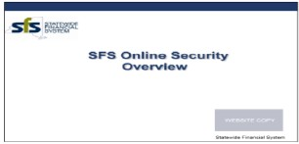

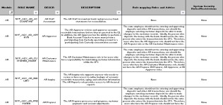

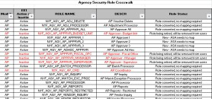

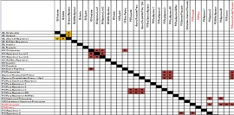
Key Role Mapping Documentation
The following documents are intended to be used by Agencies to effectively update and
manage role mapping assignments going forward:
Document Description Snapshot
Overview of SFS Security
Presentation which discusses the approach to security and data access within the SFS.
Excel workbook which provides the list of Agency roles, describes the purpose and function of each role, explains how roles relate to other roles, and how to assign users to accommodate approval workflow routing and separation of duty considerations.
Agency Role Guide
Crosswalk of Roles from PeopleSoft 9.0
to 9.2
Excel workbook which provides a crosswalk of 9.0 and 9.2 roles, and includes the list of roles retired for EE1.
Separation of Duties Matrix
Matrix which lists roles subject to separation of duties or internal control considerations.

Slide 27
Demo of Training Resources
SFS Secure
  Access to SFS (Security and Roles)
  Internal Control Officer Information Center
  Job Aids
    Administrator Queries
  SFS Query User Guide
    Administrator Query Guides
      NY_SEC_SOD_CONCERNS
      NY_SEC_ADMIN_ACTIVITY
      NY_SUPERVISOR_DIRECT_REPORTS
27
For use with New York State agency staff
and SFS users. Contents subject to change.
Notes:
Emphasize that more queries are available in the query guide
ASA Activity Query (NY_SEC_ADMIN_ACTIVITY)
Provides a list of ASA activities for a given date range, user, ASA name, permission list or role name (Self-Service activity only).
Allows ICOs to report on ASA activities proactively.
Allows auditors to compare ASA Activities to requests for role changes to ensure alignment.
Internal Control SOD Concerns Query (NY_SEC_SOD_CONCERNS)
Provides a list of users and roles that are in conflict with the published SOD
guidance.
Supports compliance with best practice guidance to SOD recommendations.
Ensures agencies have data required to comply with best practice for security administration monitoring.

Slide 28

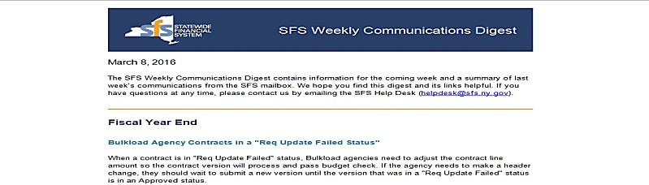

Weekly Communications Digest
Contains information for the coming week, and a run down of the most recent announcements from the SFS mailbox, along with helpful links.
Distribution Date, Audience, and summary of previous communications provided for reference

Slide 29
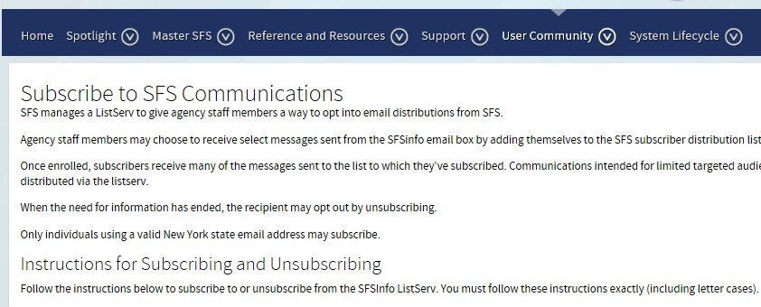
SFS Info Email Distribution List
Distribution list for key SFS communications, including the
Weekly Communications Digest
Users can self-subscribe/unsubscribe
To subscribe: SFSSecure > User Community > Subscribe to SFS Communications

Slide 30
Questions?
Does anyone have a best practice they are willing to share?
Does anyone have a particular area that you struggle
with?
If you are having a particular issue that you need help with, please open an incident with SFS Helpdesk.

