Slide 1
Statewide Financial System and
NYSICA Updates Since 2018
September 16, 2021

Slide 2
Agenda
Annual Agency Recertification (a.k.a. Annual User and Role Validation)
Automatic Account Locking
Retired, Terminated, and Deceased User Processing
Update of Key Resource: Agency Role Guide and SOD Matrix
Notes:
SFS last presented in 2018, so we will look at these topics with completely fresh eyes

Slide 3
Annual Agency Recertification

Slide 4
In April of 2018….
SFS implemented an online solution for the Annual Certification Process to replace SFS sending out files and agencies returning a paper certification.
The User and Role Validation page:
  Allows agencies to generate the needed review files at their discretion
  Provides a single form for attachment of documentation and sign off, all stored within the SFS database
  Required mapping to two new roles:
    Compliance Reviewer (often the ICO or designee); noted as CR in the following slides
    Financial Certifier (often the CFO or designee); noted as FC in the following slides
A new security work center was deployed for easy access to the User and Role Validation page.
  Provides real-time queries to assist agencies in completing their reviews

Slide 5
In the Years Since 2018…
SFS continued to enhance the User and Role Validation page to provide:
  An area to attach supporting documentation
  A comments box under the ASA, CR, and FC sections
  The ability to link multiple ASA self-service and ASA mass-upload reference numbers, under both the ASA and CR sections
  The ability for the ASA to reject and delete a review that is in progress
    Once the review is signed by the FC, the ASA no longer has the option to reject and delete

Slide 6
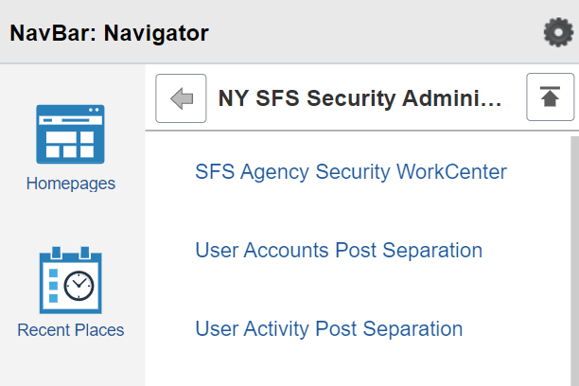
So we’d like to take you on a tour…
Log into production
Select Compass > NavBar Icon
Then Navigator > PeopleTools > Security > NY SFS Security Administration
Demo

Slide 7
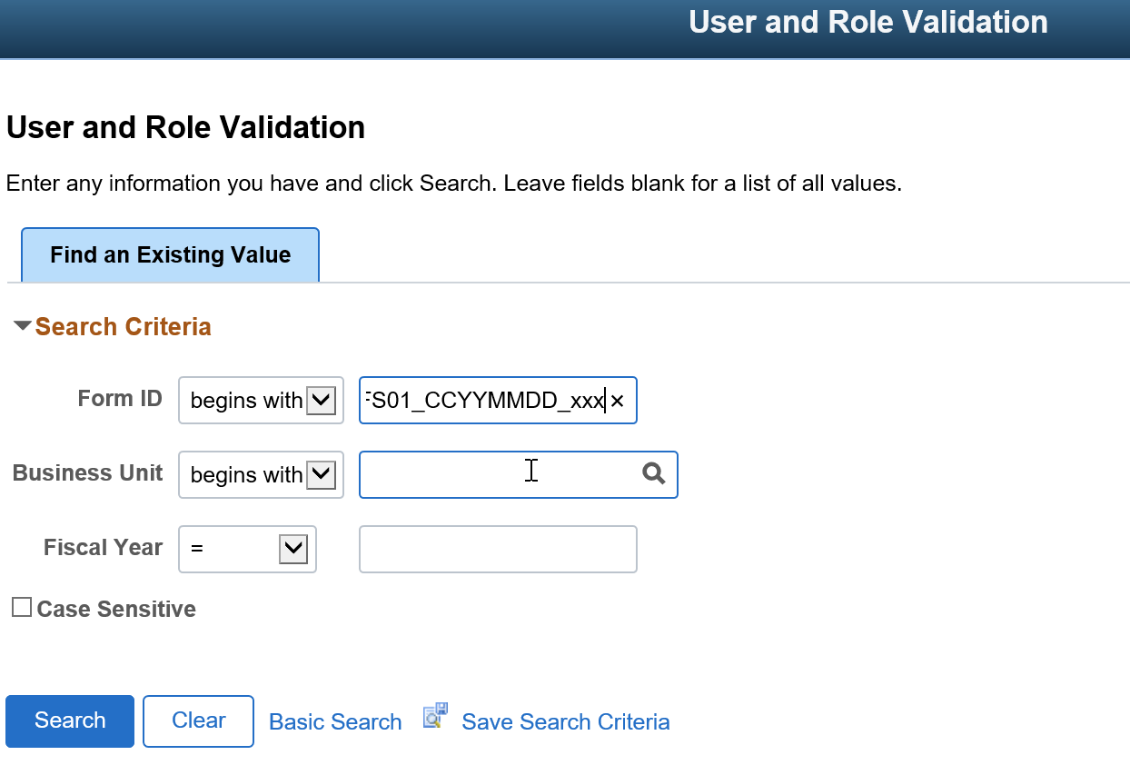
User and Role Validation
Enter the Form ID from the email.

Slide 8
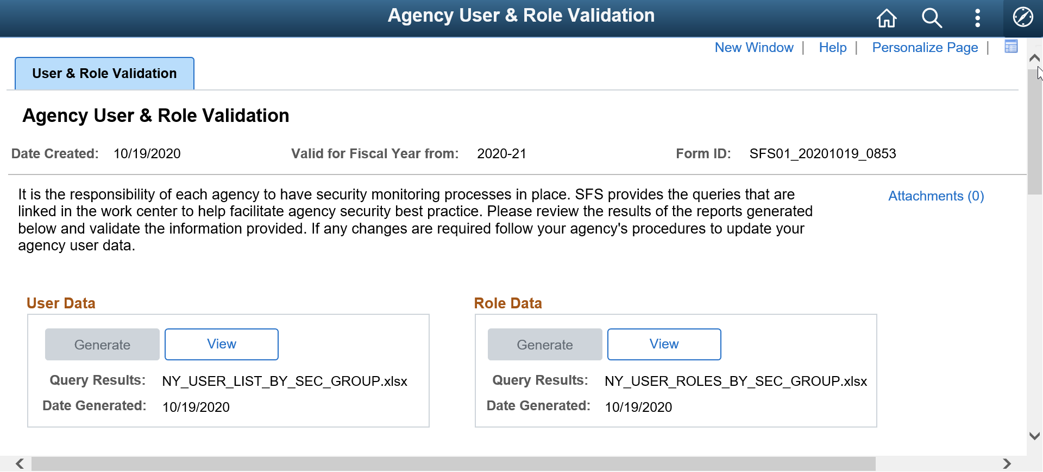
User and Role Data – Generate (ASA), View (CR, FC)

Slide 9
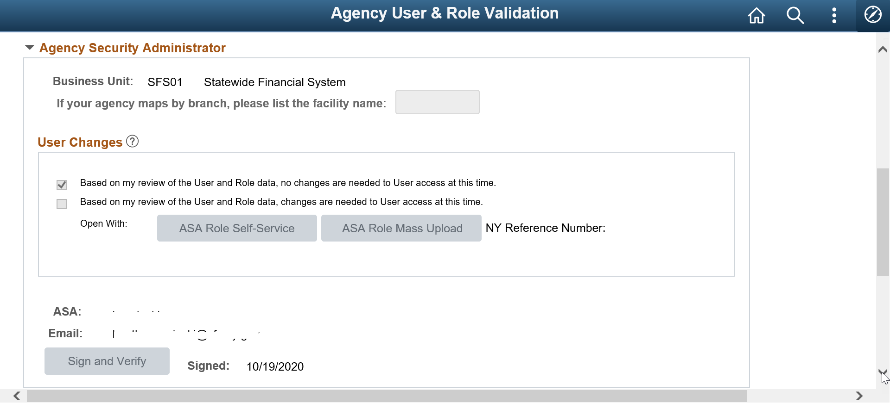
ASA Portion

Slide 10
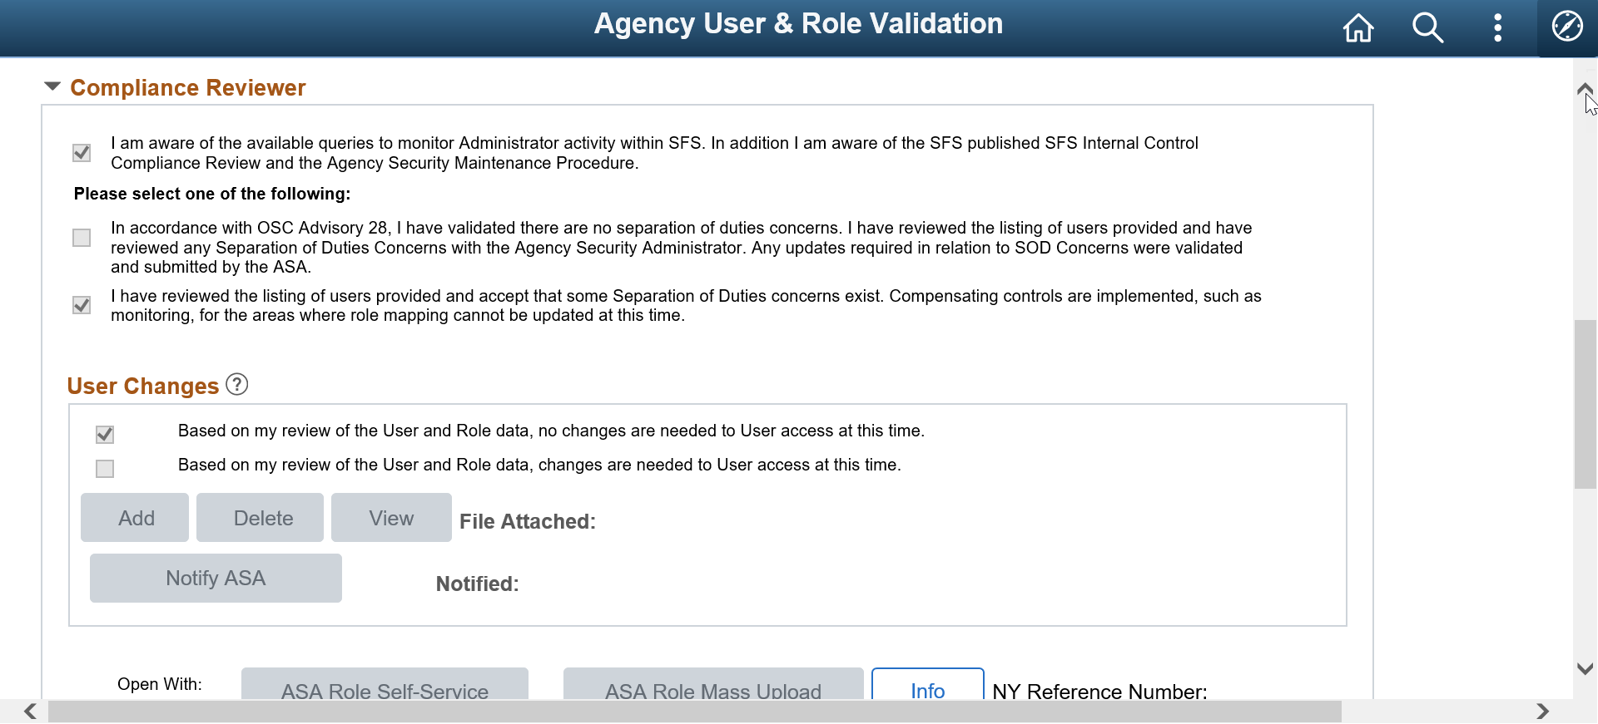
CR Portion

Slide 11
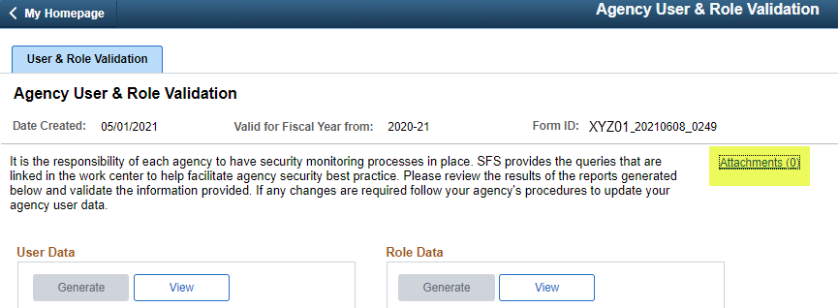
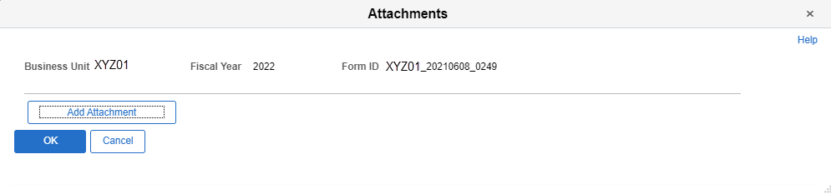
Agency Validation Page Enhancements
Attach supporting documentation:
Clicking the highlighted link will open the Attachments window seen below.

Slide 12
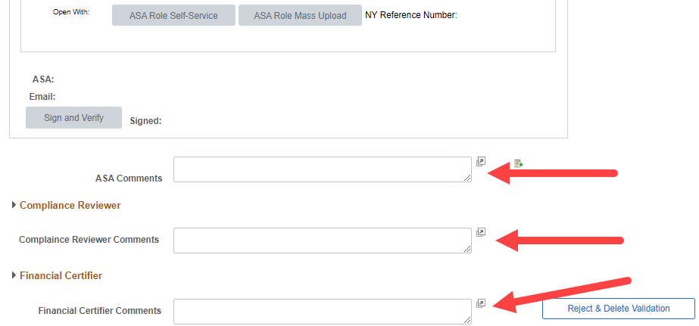
Agency Validation Page Enhancements
Comment boxes available in each Admin section of the Validation.
Notes:
In this example the Compliance Reviewer and Financial Certifier sections are ‘collapsed’ to more easily show each Comments section

Slide 13
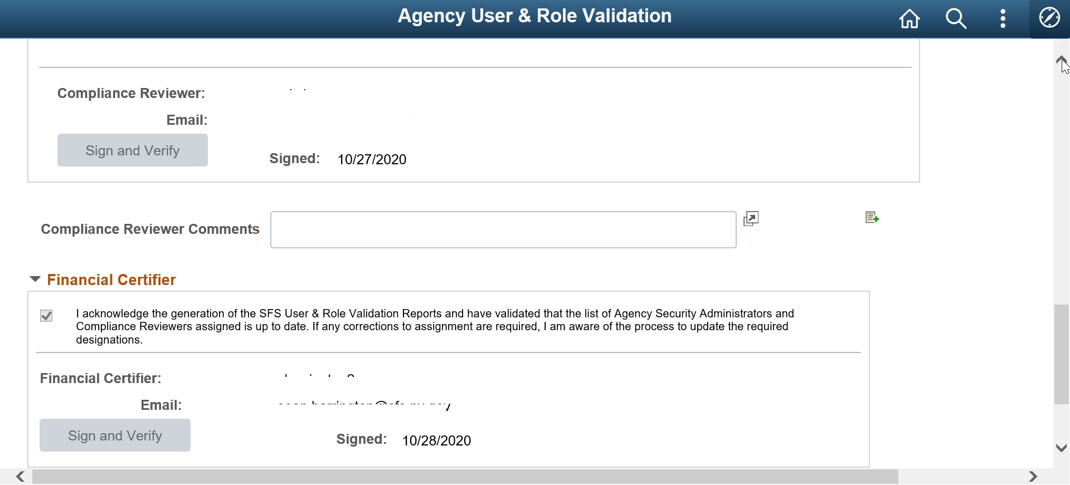
CR and FC Signoff Portions

Slide 14
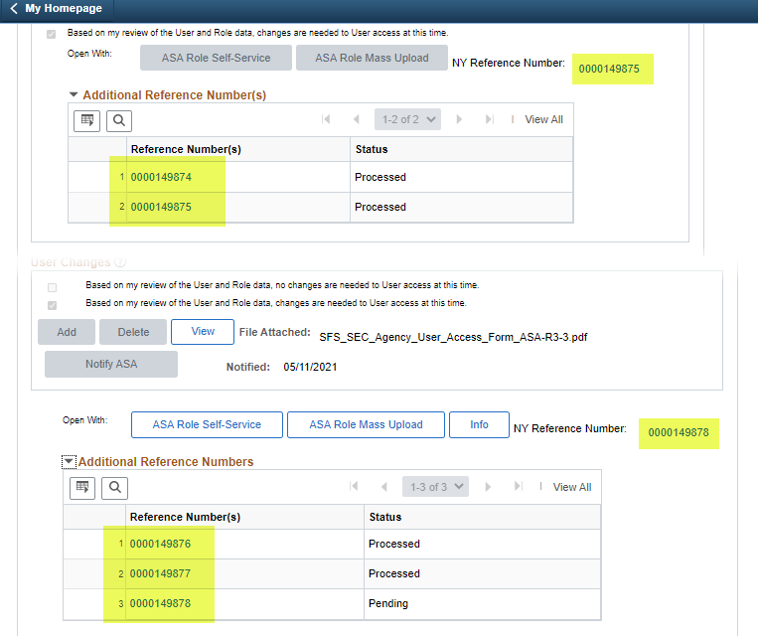
Agency Validation Page Enhancements
Multiple ASA Self-Service and/or Mass Upload reference numbers can be linked to both the ASA and Compliance Reviewer sections.
Also note that you can see if the requests have been processed or are still in a Pending status.
Notes:
As it is not clear from the screenshot, make sure they know that this screenshot is from the same Validation.

Slide 15
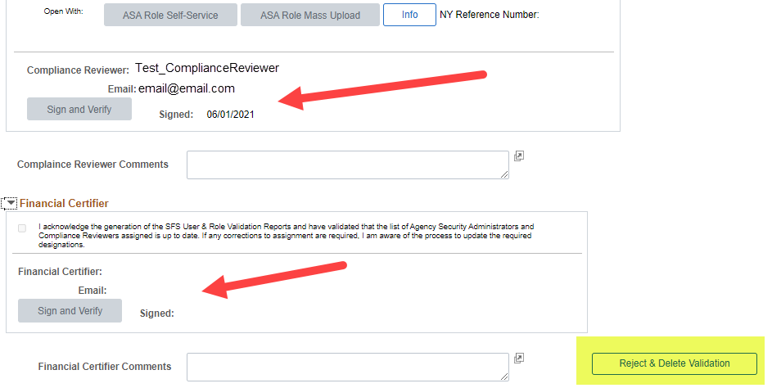
Agency Validation Page Enhancements
In the example, the Compliance Reviewer has signed their section, and the only step left is for the Financial Certifier to sign. The Reject and Delete Validation button is still available to the ASA.

Slide 16
Deadlines for Completion
The Certification must be completed at least once each fiscal year, so it must be completed between April 1 and March 31.
SFS recommends each agency complete the review by December 31, as the Annual Audit begins in January and all agencies are subject to inclusion by the auditors.

Slide 17
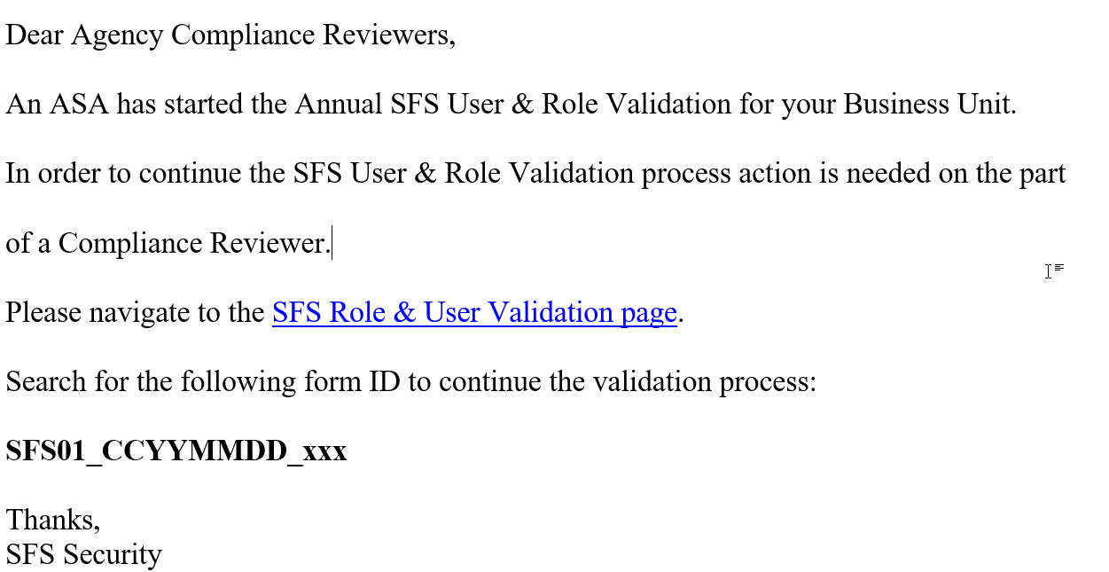
Triggers
The Certification is started at the agency’s discretion. SFS sends out a quarterly reminder regardless of whether the agency has completed the review or not.
When the ASA and CR complete their review, an email is sent out to the next person in the review cycle so they know it is time to perform their review.

Slide 18
Reminders
If the ASA has started the review but has not completed it within four weeks, the system sends a reminder to the ASA, Compliance Reviewer (CR), and Financial Certifier (FC).
If the ASA has completed the review, but the CR has not signed off within two weeks, the system sends a reminder to the ASA, CR, and FC.
If the CR has completed the review but the FC has not signed off within one week, the system sends a reminder to all three people.

Slide 19
Reminders
Three separate users need to complete validation.
  Agency Security Administrator, Compliance Reviewer, and Financial Certifier
Separation of Duties exist between the ASA primary and backup roles and the Compliance Review role.
  Part of the Compliance Reviewer’s responsibility is to monitor the Security Administration of users for their agency.

Slide 20
Training Materials
Self-Paced Training in SFS Coach (accessed via production SFS)
  ADMIN Security 205
  Compliance Reviewer 205
  Financial Certifier 205
Job Aids in SFS Coach (accessed via production SFS)
  JAA-ASA205-010
  JAA-CR205-001
  JAA-FC205-001

Slide 21
The missing ingredient – what to do before sign off?
As these are management decisions, SFS cannot tell agencies what to do. However, to assist agencies in making those decisions, OSC has an audit program and SFS has an enhanced version of the audit program for CRs to use.
Some things for ASAs, CRs, and FCs to consider:
  Are all users active agency employees?
  Do they have only the roles they need?
  Are the ASA activities in SFS appropriate?
  If there are SOD concerns, are the needed mitigation strategies in place?
  Do you have the appropriate documentation to back up the access and roles assigned?

Slide 22
Coming Later in 2021
SFS will add a new email notification to the ASA, CR, and FC to alert them to when the ASA has deleted a review after the CR has signed off, but before the FC has signed off.

Slide 24
Automatic Account Locking

Slide 25
Unused Account Locking Process
SFS executes a regular audit on the first business day of each month to:
  Lock agency user accounts that are more than 90 days old and have never been used
  Lock agency user accounts that have not been used in 180 days or more
Accounts that are locked by the audit process, and not reactivated within 180 days, will be removed from the SFS system.
  User accounts that hold travel only roles will not be removed as part of this process

Slide 26
Query to Check on Accounts Locked
NY_USER_LIST_BY_BU
  Query will display all users associated to your business unit and whether their account is locked or not. Also displayed is each user’s name, email, employee ID, primary permission list, supervisor ID, last sign on date/time, and department ID.
NY_USER_LIST_BY_PL
  Query will display all users associated to a primary permission list and whether their account is locked or not. Also displayed is each user’s name, email, employee ID, supervisor ID, last sign on date/time, and department ID.
    This query is useful for large agencies that have many SFS users associated to multiple primary permission lists.

Slide 27
Notification for Locked CRs and FCs User Accounts
SFS has implemented additional email notifications to inform ASAs, CRs, and FCs when either a CR or FC user account becomes locked as part of the audit process.
  When the notification is received, the ASA has the ability to unlock and reset the password for the CR and FC user account directly in SFS.
    Once the user account is unlocked and password reset, the CR and FC should log into SFS so that their account remains active.
    However, accounts that are locked by the audit process, and not reactivated within 180 days, will be removed from the SFS system.

Slide 28
Coming Later in 2021
SFS locks user accounts that are only associated with the Traveler role. These accounts are not removed from SFS, even when they are locked. Later this year, SFS will treat user accounts that are associated to certain Requester roles in the same way as travelers are treated. More information will be forthcoming in regards to this change.
Staff that have certain Requester roles may be locked but not deleted. This would be that same as we do for staff with a travel role. More information will be forthcoming in regards to this change.

Slide 30
Retired, Terminated, and
Deceased User Processing

Slide 31
A Key Control
Twice each week SFS processes data from Payroll.
One aspect of that processing is looking at SFS users who have Retired, Terminated, or are Deceased.
  Ensure these accounts are locked
  Ensure the accounts have not been used by anyone after the RTD date as reported by Payroll
    Very important agencies update Payroll as soon as possible (within a few days)
    Very important agencies update the related online pages when informed by SFS that post-RTD activity has been identified

Slide 32
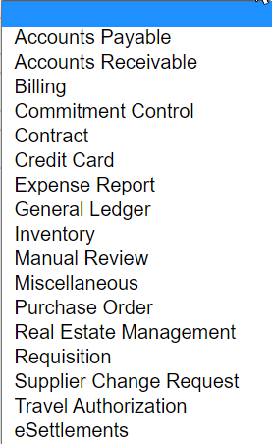
RTD Processing
SFS posts RTDs to the User Account Post Separation Page.
If such activity is identified, it is posted to the User Activity Post Separation page and the agency is notified by email.
A variety of activities are examined:

Slide 33
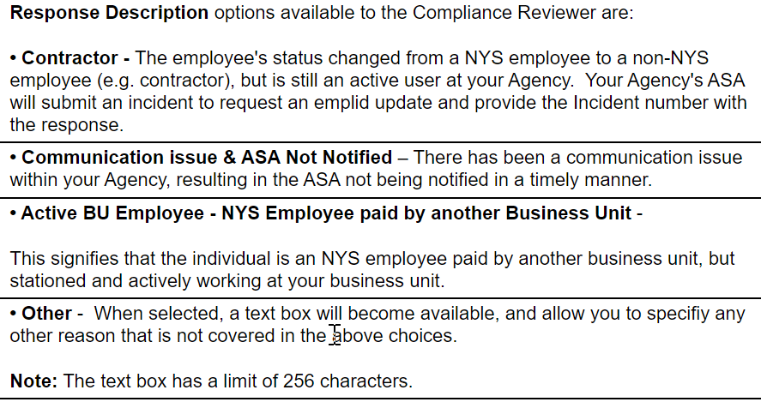
RTD Processing
The ICO must review the activity and post a response as to the outcome of that review. The review should be completed in 30 days or less, or it can become an audit finding.

Slide 34
How you get there
Log into production
Select Compass > NavBar Icon
Then Navigator > PeopleTools > Security > NY SFS Security Administration

Slide 35
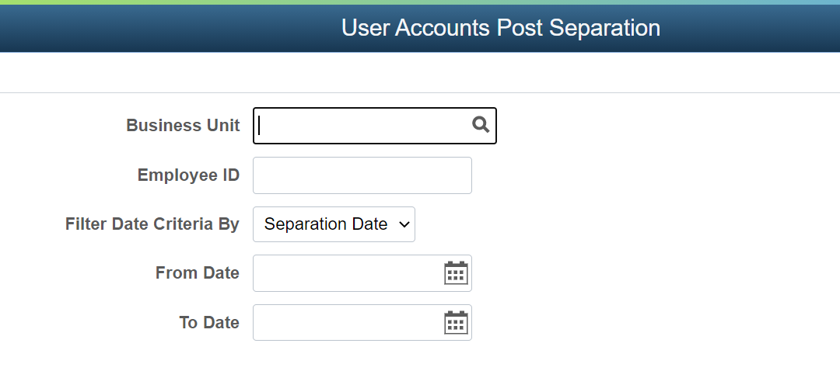
User Account Post Separation Page

Slide 36
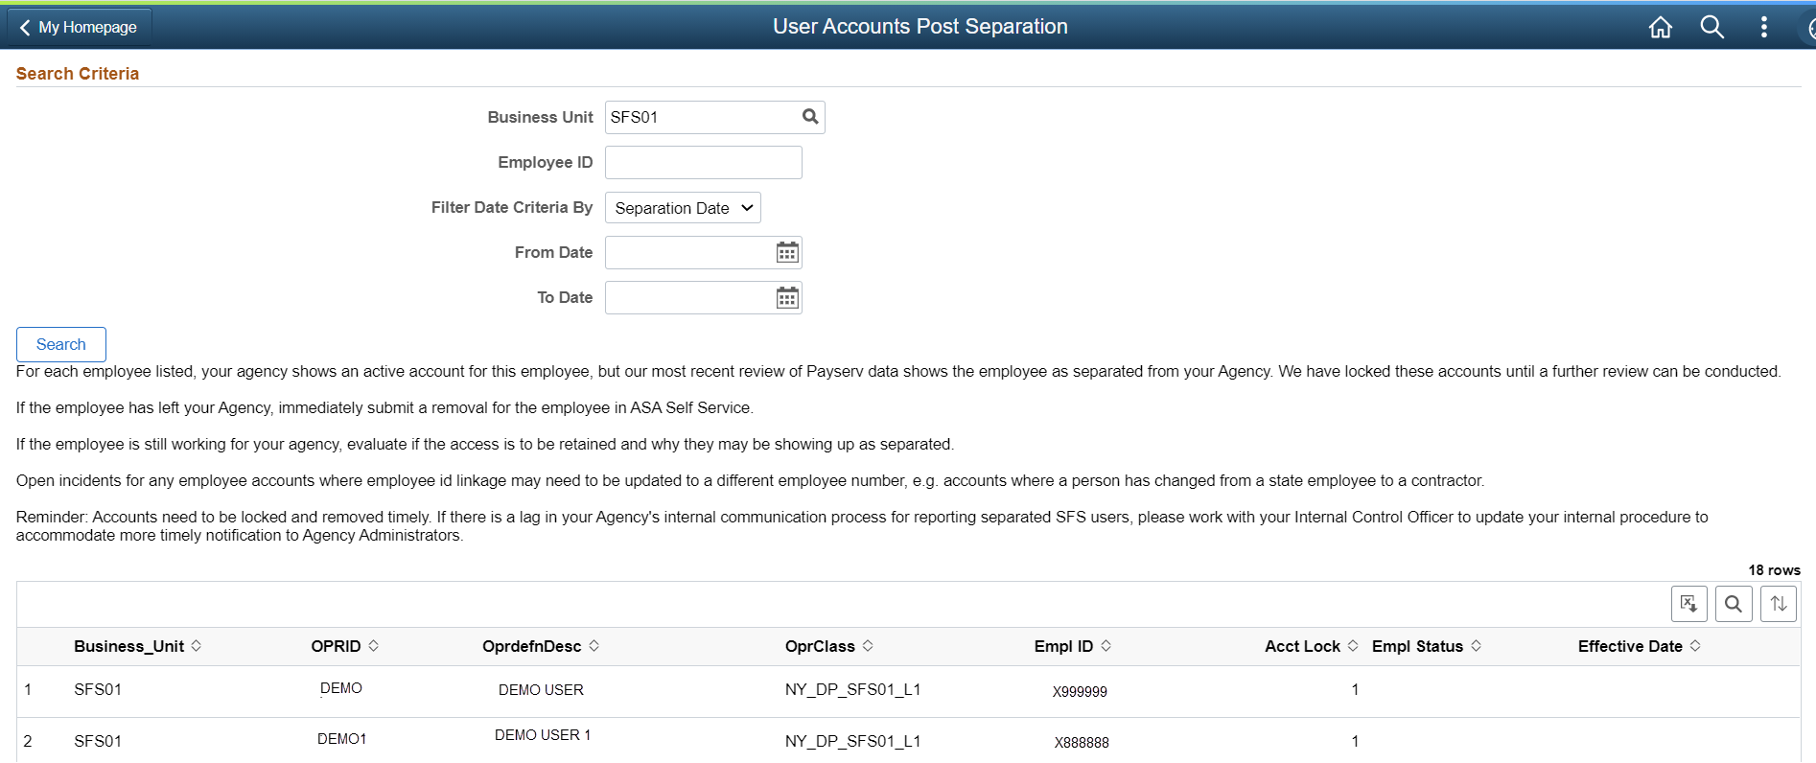
User Account Post Separation Page
Just because a user is listed, does not mean they have post-separation activity. This is just a list of SFS users who have a status of RTD.

Slide 37
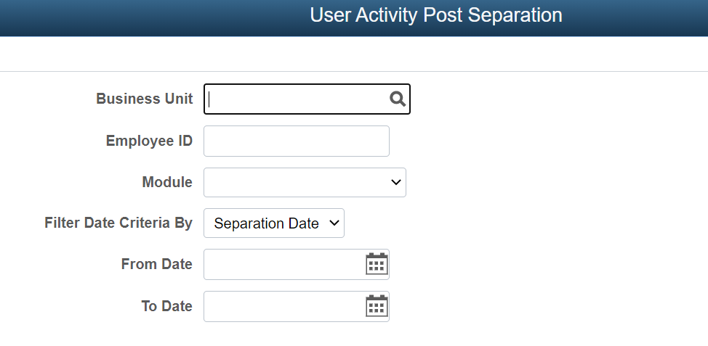
User Activity Post Separation Page

Slide 38
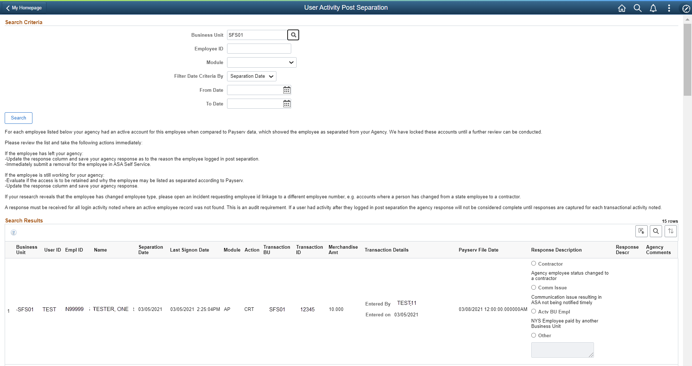
User Activity Post Separation Page

Slide 39
RTD Training Materials
Self-Paced Training in SFS Coach (accessed via production SFS)
  ADMIN Security 205
  Compliance Reviewer 205
  Financial Certifier 205
Job Aids in SFS Coach (accessed via production SFS)
  JAA-ASA205-012
  JAA-CR205-003
  JAA-FC205-003

Slide 41
Update of Key Resource
Agency Role Guide and SOD Matrix

Slide 42
Agency Role Guide and SOD Matrix Improvements
In an effort to provide clarity on SFS roles and role mapping advice, these two documents have been combined into one document.
The new combined guide provides links between the SOD matrix tab and the Role Guide tab so that Users can find all information available for a particular role quickly and easily.
The new combined guide has been published on SFSSecure under References and Resources > Access to SFS (Security and Roles).

Slide 43
Agency Role Guide and SOD Matrix Improvements
Demonstration:
Agency Role Guide and
Separation of Duties Matrix

Slide 44
Agency Role Guide and SOD Matrix Improvements
Agency Security Administrator, Compliance Reviewer, and Financial Certifier roles are provisioned by a designation process.
  These roles are not available for assignment by the ASA self-service or ASA mass upload process.
  SFS Security staff provision these roles for users designated by the agency.
  If a new designation will cause a role conflict, SFS Security will reach out and work with the agency so that a conflict is not created.
  Roles provisioned by a designation process are noted in the Role Guide tab, but are not included on the SOD Matrix tab.

Slide 45
Access Agency Role Guide and SOD Matrix
Access to the Agency Role Guide / SOD Matrix is via SFS Secure
SFS Secure / References and Resources / Access to SFS (Security and Roles)
If you do not have access to SFS Secure, contact your agency’s PODA (Participating Organization Delegating Administrator) for assistance
  The PODA is often in the agency’s IT department

