Slide 1

KEY RISKS AND CHALLENGES
LEADERS MAY FACE IN 2022
AND WHERE YOU MIGHT FOCUS
NYS Agencies, Authorities & Commissions
NYSICA Presentation - April 21, 2022

Slide 2
WHAT MAY LIE AHEAD
The last two years have been difficult and 2022 may prove to be just as challenging.
NYS agency, authority and commission (“Organizations”) leaders will likely have to:
  Continue to navigate through the pandemic
  Deal with the fallout from global conflicts
  Adjust to inflationary pressures and supply chain disruptions
  Embrace innovation driven by technology
In fact, there is a confluence of risks with uncertain outcomes
Internal Control Officers, Internal Auditors, and Risk Specialists play a key role by:
  Making sure risk is “top of mind” of your Senior Management (and Board)
  Advocating the importance of risk reduction by highlighting its potential benefits:
    Enhanced citizen, employee, and vendor relationships
    Strengthened controls
    Decreased operational, legal, and compliance costs
    Reduced likelihood of litigation and adverse media attention
    Improved efficiency and performance
  Factoring the applicable risks into your risk assessments, audit plans and work
While there is no crystal ball, there is real value in looking ahead.

Slide 3
STRATEGY AND GOVERNANCE
Sustainability And The Environment
Current Situation
Worldwide carbon emissions and lax environmental practices have:
  Polluted the water, ground, and air
  Increased the frequency/severity of heat waves, floods, hurricanes, and droughts.
  Allowed the growth of vector-based parasites
  Contributed to the rise in asthma and cancer
Organizations must be “good corporate citizens” and commit to sustainability:
  Investment to enhance resiliency
  Positive impact on the environment
  Important component of ESG strategy
  Of interest to the SEC for public company reporting
Employees, citizens, customers, investors, regulators and media are watching
Some progressive government sustainability initiatives include:
  Recycling programs for cartons and paper
  Installing solar panels on public infrastructure
  Providing incentives to businesses (e.g. wind farms)
  Reducing employee work-related travel
  Replacing gas guzzling vehicles (e.g. buses)

Slide 4
STRATEGY AND GOVERNANCE
Sustainability And The Environment
Potential Focal Points
Does your Organization have a Sustainability or ESG program? If yes:
  Assess program design including are there:
    Reasonable goals and commitments?
    Defined priorities?
    Designated responsible leaders?
    Established framework (e.g. Global Reporting Initiative)?
    Use of relevant data and consistent metrics?
    Comparison of information disclosures to peers?
  Verify that the reported progress can be substantiated by sound data.

Slide 5
STRATEGY AND GOVERNANCE
Changing Laws, Regulations And Policies
  Current Situation
  Laws and regulations will continue to change. Some examples:
  Federal- data privacy, fossil fuel use, infrastructure, drug prices
  State/local- generation of additional revenues, more frequent in-depth building inspections, licensing rules (e.g. cannabis)
The pandemic may further influence policies, legislation and possibly litigation:
  Executive authority granted during pandemic
  Local versus. state control of funding for schools, public health and infrastructure
  Potential Focal Points
What laws and regulations apply to the Organization?
Who is responsible for ensuring and verifying compliance?
Have policies and procedures been revised to reflect recent changes?

Slide 6
STRATEGY AND GOVERNANCE
Leadership, Culture And More
Current Situation
Leaders set direction and assume responsibility for the Organization’s fiscal health
Unlikely any leader was:
  Alive during the smallpox pandemic
  Dealt with 1970s inflation
Organizations need realistic and achievable goals given uncertain conditions
Sound governance and tone-at-the-top are also essential
  Promoting a positive culture and appropriate behaviors
  Avoiding a toxic environment that poses reputational, legal and financial risks
Potential Focal Points
Are employee surveys available or can inquiries be made to assess:
  Culture, sense of community, values and trust?
  Effective communication regarding mission, direction, projects and programs?
  Level of engagement, job satisfaction, governance and control structure?

Slide 7
Polling Question 1:
How often does management evaluate non-financial risk?
Daily
Monthly
Annually
Not Sure
Not at all

Slide 8
STRATEGY AND GOVERNANCE
Geopolitical Instability
Current Situation
Escalating global tensions and regional conflicts may impact trading partners or companies Organizations rely on:
  Imposition of sanctions
  Supply shortages and price spike (e.g. energy, wheat, other commodities)
  Logistics delays and factory closures
  Imposition of tariffs and taxes by a foreign government
  Foreign governments investigate or assume ownership of US subsidiary
Potential Focal Points
Is there any exposure to foreign suppliers? If yes, is a contingency plan in place?
Are there safeguards to protect against attacks to the:
  Physical infrastructure (e.g. utilities, facilities)?
  Information technology, whether on-premises or cloud-based?

Slide 9
OPERATIONS
Resilience, Continuity and Crisis Management
Current Situation
US experience over the past decade - many events occur with little/no prior warning:
  Natural disasters
  Man-made accidents
  Civil unrest
  Increase in criminal activity
Organizations may have standalone Emergency Management, Business Continuity, Information Technology Disaster Recovery and Crisis Management Plans.
When activated, they discover:
  Never considered full range of threat scenarios (e.g. active shooter), impact, duration, and complexity of resource mobilization
  Plans and testing siloed and not cohesive/coordinated
  Existing documentation dated and/or incomplete
  Key person risk

Slide 10
OPERATIONS
Resilience, Continuity and Crisis Management
Potential Focal Points
  Have the Organization’s leaders considered a broad array of threats?
  Are there formal training and testing procedures?
  Are there appropriate mitigation measures?
  Is the process for restoration of operations fully documented?
  Does a thorough post-event or post-test analysis always occur that addresses:
    What worked well?
    Did the actual results deviate from expected results?
    Were areas for improvement noted and then acted upon?
What would happen if multiple events occur concurrently (e.g. severe building flooding during a pandemic and then looting)?
Is there a need for more integrated planning?

Slide 11
OPERATIONS
Supply Chain Disruptions
Current/Emerging Situation
2021 supply chain issues continue in 2022:
  Covid outbreaks, bad weather, customer demand
  Logistics, port congestion, trucking, labor and equipment shortages
It is not just a challenge for the manufacturing, distribution, logistics, and retail sectors
Government depends on:
  Chips for computers, equipment, and vehicles
  Office and maintenance supplies
  Food for social service programs
  Building materials for infrastructure projects, leasehold improvements, and repairs.
  Potential Focal Points
Is there supply chain visibility, known bottleneck points, and captured metrics ( e.g. backorders, cancellations)?
Are alternative measures in place?
  Use of other suppliers or concentrate on fewer vendors
  Source in the Americas
  Substitute materials (e.g. plastic for metal piping)
  Forward buying of non-perishable goods
  Reroute shipments (e.g. air, rail) to circumvent ports
  Borrow from others who hold reserve stock

Slide 12
OPERATIONS
Performance Measurement
Current Situation
Use defined performance measures to track progress in meeting overall objectives
Traditional measures focus on:
  Productivity
  Efficiency
  Effectiveness
Outcome measures are a valuable add-on (e.g. improve pedestrian safety - number of speeding tickets or accidents)
Potential Focal Points
Are performance metrics used?
Do they focus on traditional and/or outcome measures?
Are managers held accountable?
Are funding levels increased to reward good performance?
.

Slide 13
HUMAN CAPITAL
Workforce Attraction, Retention And Development
Current Situation
Unprecedented wave of resignations in USA:
  Turnover maybe due to many factors:
    Early retirement
    Fatigue and burnout
    Relocation
    Avoidance of in-office infection
    Work-life balance
    Changing personal goals and careers.
  Easy to change jobs from home (e.g. mail-in laptop)
  Competition with private sector for young talent
  Relatively low level of immigration to fill vacant positions
Employee isolation from colleagues and the citizens they serve
Social and interpersonal relationships erode

Slide 14
HUMAN CAPITAL
Workforce Attraction, Retention And Development
Potential Focal Points
What are the organization’s trends in hiring, retention, and promotion?
For turnover:
  Is the cause understood and does it vary by generation, level, or location?
  Is there key person risk and a succession plan to address it?
Is there an opportunity to rethink:
  Culture, trust, connectivity, communication, and collaboration?
  Operations and organizational model?
  Giving employees a voice in decisions?
  Sharing collective goals and linking employee contributions to strategy?
  Providing upskill/reskill opportunities?
Can retention be improved by:
  Adjusting staffing models, allowing telework, allowing flexible schedules and/or staggered schedules, and perhaps hiring seasonal staff?
  Outsourcing non-core functions?
  Assigning mentors/buddies to new hires?
  Recognizing high performers?

Slide 15
FINANCE
Changing Economic/Inflationary Conditions
Current Situation
Governments often have backlog of infrastructure needs but lack sufficient funding.
Leaders should closely monitor their fiscal position and cash flow since there are a number of variables that are not under their direct control:
  Inflation effect on revenue streams and expenses
  Recession may impact sales and income tax collections or federal government may reduce program support
  Residents may relocate out-of-state; cost of services then spread over a smaller base
Potential Focal Points
How is the Organization performing relative to budget/plan?
Have there been operational, programmatic, or capital project adjustments?
Are the budgets based on realistic assumptions?
What actions would be taken under the worst case scenario?
Are the total cost of programs, services and projects known and are they fiscally viable?
Has fraud risk increased due to remote/hybrid work and other operational changes?
Are revenues and spending continuously monitored and re-forcasted?
Can unused/excess space/facilities be repurposed to generate revenue?

Slide 16
FINANCE
Insurance Availability And Coverage Cost
Current Situation
Premium costs are increasing across many insurance lines:
  Cybersecurity attacks and the exposure of sensitive information
  Storm intensity that causes flooding, erosion, and infrastructure damage
  Motor vehicle accidents and fatalities
  Long-term care costs as seniors live longer and require more expensive care
  Pandemic-related incidents that result in health and life benefit payouts
Deductibles are rising and coverage limits declining and policies maybe hard to obtain:
  Some insurers are exiting certain geographies
  Policies maybe dropped if they do not meet profitability targets
  Now there are covid-related exclusions
Potential Focal Points
Since insurance is an important mechanism for the transfer of risk, what is the Organization doing to further mitigate or control their risks?
Is there good lifecycle control over their assets:
  Tracking cradle-to-grave (e.g. acquisition, deployment, repair, upgrade, disposal)
  Valuation and useful life
  Existence and location

Slide 17
Polling Question 2
Are employees provided enough IT security training to stay abreast of today’s cyber threats?
A) Absolutely
B) No
C) Not sure
D) It’s never enough

Slide 18
Risk Management
INFORMATION SECURITY
Managing IT Risks
NIST Special Publication 800-37 Rev. 2, Risk Management Framework for Information Systems and Organizations: A System Life Cycle Approach for Security and Privacy
Five Steps
Identify – Defining the Risk Universe
Assess – Probability and Prioritization
Mitigate – Eliminate or Contain
Monitor – Track, Identify, and Evaluate
Report – Communicate Progress, Changes, and Challenges

Slide 19
Prevention, Detection, and Response
INFORMATION SECURITY
Managing IT Risks
NIST Special Publication 800-53 Rev. 5, Security and Privacy Controls for Information Systems and Organizations
Control Families
Access Control | Physical and Environmental Protection
Awareness and Training | Planning
Audit and Accountability | Program Management
Assessment, Authorization, and Monitoring | Personnel Security
Configuration Management | PII Processing and Transparency
Contingency Planning | Risk Assessment
Identification and Authentication | System and Services Acquisition
Incident Response | System and Communications Protection
Maintenance | System and Information Integrity
Media Protection | Supply Chain Risk Management

Slide 20
TECHNOLOGY
Digital Transformational And Disruption
Current Situation
Progressive organizations assess Information Technology effectiveness:
  IT strategy, planning, governance, talent, competencies, budget, capabilities and compliance
  Hardware and network infrastructure performance, reliability, scalability, and availability
  Applications portfolio (e.g. financial, human resources, operations), software development maintenance and anticipated useful life before replacement, and level of integration
  Operations, security and disaster recovery practices, and role of cloud providers
  Quality and utility of services provided to the internal and external user community
Government can capitalize on newer technologies:
  Contact-free and self-service platforms for e-commerce, online portals (e.g. tax payments)
  Information sharing tools for transparency, collaboration and communicating.
  Embedded intelligence/sensors in devices, buildings, equipment and vehicles (e.g. GPS.)
  Artificial intelligence (e.g. decision making)
  Virtual learning (e.g. vehicle repair training)
  Data analytics (e.g. spending patterns)
  Reporting dashboards and data visualization
  Drones for visualizing structural defects in tall buildings or bridges
However, digital transformation may be disruptive and can create new risks

Slide 21
Polling Question 3
Do you feel confident about the quality of your data that you analyze, bill or report on?
A) Absolutely
B) No
C) Not sure

Slide 22
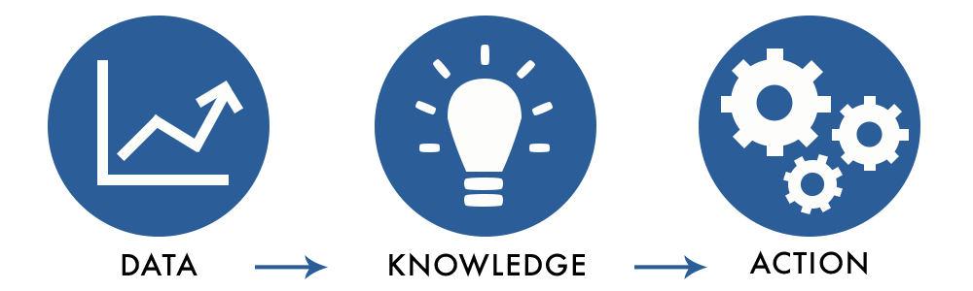
What data do you create, manage, and consume?

Slide 23
DATA SPRAWL
Data Growth
unknown severity
Resources
for data discovery & risk analysis

Slide 24
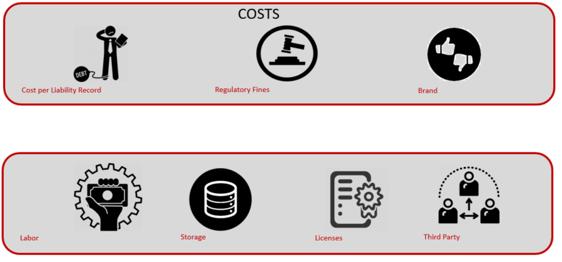
WHAT IS DATA RISK?
Exposure Risk
  Monetize value of sensitive data according to regulatory fines and fees, or form of records exposed in hacks, breaches, misuses of data.
  Probability and Severity
Operational Risk
  Day-to-day operational expenses and taxes on data
  Driven by data redundancy and data sprawl

Slide 25
DATA RISK MANAGEMENT
Governance
Security
Transformation
Regulations
Strategy
Management
24

Slide 26


PEOPLE VS. SYSTEM-ORIENTED FRAMEWORKS
Previous Data Governance Initiatives
Pockets of highly skilled resources that have been strategically
rationed over time
People-Oriented
Failure after a certain inflection point in scale
Sustainable Data Governance Initiatives
It becomes fused into every aspect of the organization
System-Oriented
Scalable and integrated in workstreams (combining people/process/technology)
PHASE I
PHASE II
PHASE III

Slide 27
POOR DATA QUALITY
Impact
Inability to invoice correctly
Increase service calls
Increase exposure to fraud
Poor reporting or analytics
Contributing Factors
Poor system implementation
Creating silo approach
Lack of documentation
Lack of governance

Slide 28
VENDOR RISK MANAGEMENT PROGRAM
Due Diligence / Planning
Risk Management
Contract Management
Monitoring
Termination
Provide a risk rating for each vendor
Create a schedule for review
Identify triggers that would escalate the review
Identify & manage evidence
Evaluate vendor risk
Manage & remediate vendor risk
Report on vendor risk
Governance
Notes:
The third party risk management process should be a continuous process.
Governance
Develop proper due-diligence on 3rd party selection, developing contracts that clearly defines expectations and responsibilities to ensure enforceability, limit liability, mitigate disputes about performance.
Risk Identification and Assessment
Why? – could fail to meet expectations, significant impact to customers, require significant investment in resources to implement 3rd party relationship, major impact on operations if the company has to find an alternative 3rd party.
Evaluating the risk levels:
Discuss the risk inherent with the process
Outline strategic purposes (i.e. reduce cost, leverage expertise or technology)
Assess the complexity of the arrangement
Determine whether the potential financial benefits outweigh the estimated costs
Assess the nature of customer interaction
Assess potential information security implications
Consider contingency plans in the event the company needs to transition the activity to another 3rd party or bring it in-house
Assess the extent to which the activities are subject to specific laws or regulations
Triggers that would impact:
acquisitions, divestitures, joint venture
changes in compliance
key personnel leave
your policies or procedures change in response to changes in threats or new vulnerabilities
reliance on subcontractors
volumes increase
customer complaints

Slide 29
Question 4
Which SOC Report(s) will include the evaluation of the service provider’s internal control design and effectiveness?
SOC 2 Type 2
SOC 2 Type 1
SOC 1 Type 2
Both A and C

Slide 30
BENEFITS OF A SOC REPORT
Identify control gaps within the control environment and baseline against best practices
Help mitigate or eliminate multiple request from prospective clients, clients and their auditors
Utilize SOC reporting as a product differentiator from the competition
Reduces reputational risk of the Company, which may occur due to a breakdown of the control environment
Improving operational efficiency and risk management
Increase transparency by having an independent third party evaluate the sufficiency, design, and operating effectiveness of controls surrounding client impacting processing

Slide 31
SOC REPORTS
SOC 1
Focused on an user entities’ financial statements or internal controls related to financial reporting
SOC 2
Trust Services Categories (TSC) and criteria
SOC 3
Any interested parties who do not have sufficient knowledge to understand a SOC 2 report.
Non-branded reports
Security is the Common Criteria across all Categories
SSAE 18, ISAE 3402
Technology focused

Slide 32
SOC REPORT CONTENT
Section | SOC 1 | SOC 2
I | Independent Service Auditor’s Report | Management’s Assertion
II | Management’s Assertion | Independent Service Auditor’s Report
III | Description of Service Organization’s System
IV (Type 1) | Control Objectives and Related Controls | Trust Services Categories, Trust Services Criteria and Related Controls
IV (Type 2) | Control Objectives, Related Controls, Service Auditor’s Tests of Controls and Results of Testing | Trust Services Categories, Trust Service Criteria (TSC), and Related Controls, Service Auditor’s Test of Controls and Results of Tests
V (Optional) | Other Information Provided by Service Organization Not Covered by the Service Auditor’s Report

Slide 33
TRUST SERVICE CATEGORIES
Security – the system is protected against unauthorized access (both physical and logical).
Availability – the system is available for operation and use as committed or agreed.
Processing Integrity – system processing is complete, accurate, timely, and authorized.
Confidentiality – information designated as confidential is protected as committed or agreed.
Privacy – personal information is collected, used, retained, disclosed, and disposed of in conformity with the commitments in the entity’s privacy notice and with criteria set forth in Generally Accepted Privacy Principles (GAPP) issued by the AICPA and Canadian Institute of Chartered Accountants.

Slide 34

SOC 2 TRUST SERVICE CRITERIA
COSO
5 Components of Internal Controls
CC1.0 – Control Environment
CC2.0 – Communication and Information
CC3.0 – Risk Management
CC4.0 – Monitoring Activities
CC5.0 – Control Activities
CC6.0 - Logical and Physical Access Controls
CC7.0 – System Operations
CC8.0 – Change Management
CC9.0 – Risk Management

Slide 35

CONTACT INFORMATION
Larry Baye
Principal
lbaye@pfod.com
Mark Bednarz
Partner, Risk Advisory Practice Leader
mbednarz@pkfod.com
Rodney A. Green
Senior Manager
rgreen@pkfod.com

