Slide 1
NYSICA 2016Membership survey
April 28, 2016

Slide 2
2016 Survey
25 responses from organizations
18 State Agencies
5 Public Authorities
2 other (consulting firm and commission)
19 questions
Notes:
We received 25 responses out of membership is around 65-70 organizations.
18 State agencies
5 public authorities
A commission
And a consulting firm
All indicated there was a named internal control person (Internal control Officer)
About half compared to 2013
Comparatively
2013- 51 responses, 45 organizations.
State 35
Authorities 5
Other 5

Slide 3
Notes:
About 60 percent report to the Head or Operational Head of the Organization. This is a decline from 2013. What was added this year is 20 percent report to another designee at the senior staff level. For the rest, it appears that most report to the head of Admin, finance or some similar title and still others report to the Internal Audit Director.

Slide 4
Notes:
In 2013 we broke the question out by grade level. Not sure how this compares to now. Currently Over 1/2 of Internal Control Officers hold executive or senior management positions. This seems in line with other duties as well as the next slide. I also hope that it is reflective of the importance that organizations place on this function.

Slide 5
Notes:
The first 4 items are inline with what we traditionally think of for an Internal Control Officer’s duties in New York Government. As with the 2013 survey it appears we are expanding our duties to other areas of risk management. This actually mirrors private industry.

Slide 6
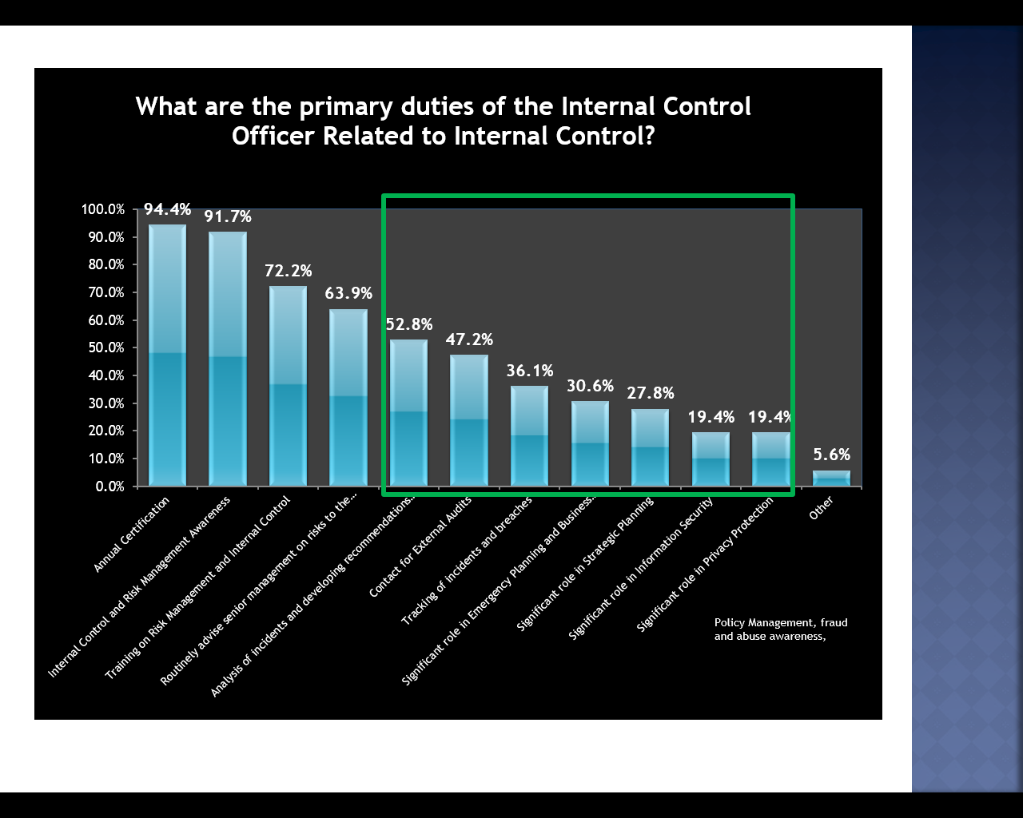
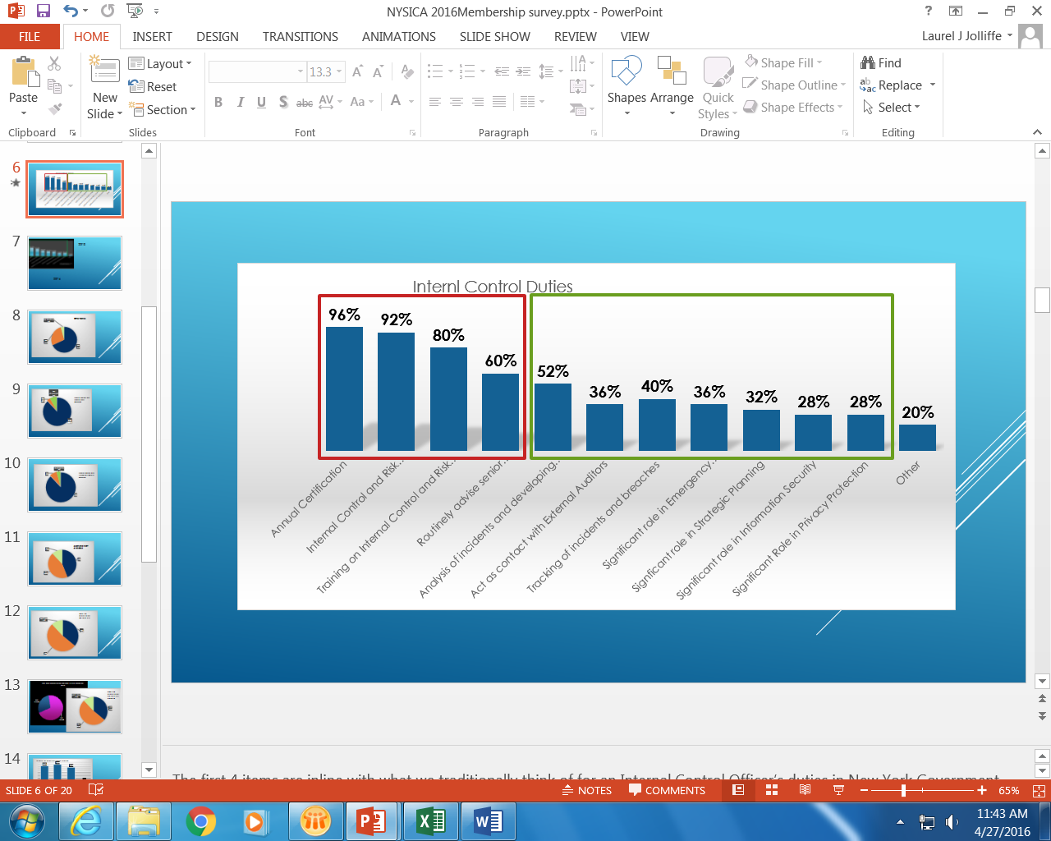
2013
2016
Notes:
Such items as tracking incidents and recommending improvements, Emergency Planning and Business Continuity , Strategic Planning and Information security which are all based in risk analysis. Yes it does appear we are maturing. From 2013, Incident tracking, emergency planning. Information security and privacy are all up. The only category that dropped was dealing with external auditors.
For the Other category there is an increase. Not everyone that responded with Other describe, but a few did and some of those items included Strategic planning and IT Security.

Slide 7
Notes:
Over 2/3 of ICO’s have other duties outside of Internal control and risk management

Slide 8
Notes:
This is essentially the same as in 2013 (if the no responses are really just no).

Slide 9
Notes:
Now ironically we see similar numbers for Information Security. This is not required to be separate and technically is an area of internal control. This may also be reflective to the organizing of IT in a central location for State agencies.

Slide 10
Notes:
About 50/50 on the staff available. This unfortunately is a drop for 2013 survey were we found approximately 60 percent had staff. This year 22 responses indicated staffing between 1 and 3 and 6 indicated staffing of 4 to 6. In 2013 we found that there was on average 1.75 staff assigned in addition to the ICO. Because of the wording change in the question—its difficult to compare that data. This could impact implementing the standards, so alternatives should be pursued such as those suggested in the previous survey of cross agency teams

Slide 12
Notes:
We see some improvement with identifying risk tolerance. Again indicating a growing maturity in risk management.

Slide 15
Notes:
12 said they had electronic systems

Slide 17
Notes:
Pretty predictable. The interesting things were:
Facilitated Risk Assessment sessions
Monthly Executive Level meetings focused on Risks and Controls
Participation in Agency-wide events
Teaming up with other risk/control functions and focusing on specific areas (fraud, privacy, information security, emergency planning)
Annual surveys

Slide 19
Notes:
I think these are fairly in line with what we would think with resources topping the list.
Interestingly this is up from 2013 which was 46%. Management support was number one in 2013 at almost 54%.

Slide 20
Notes:
Finally, NYSICAs take away. As you can see, more than half of responders want more training on internal controls and implementing the act. I would suspect that the 2nd category actually overlaps with the first. NYSICA will use this to help establish our program of presentations for the coming year. But I am also hoping today will address some of this
In addition, there seems to be a call for forms tools and even a how too guide on implementing, promoting and monitoring controls.
As some of you may be aware, we have been updating our web site and as part of this, we reviewing our library of presentations and tools. Most of that is available, but pleas shoot us a not if there is a specific item you are looking for.
We will also use this as a new call to develop and obtain tools for you to access. This is probably a good time to mention that if you have material you think is worth sharing, then please reach out to any of the board members.
To wrap up, we are still looking over this data and will continue to learn from it to help address your concerns and meet your needs.
This slide show will also be posted online for your reference.

Slide 21

NYSICA
New York State Internal Control Association
Thank You - We Look Forward to Continuing to Meet Your Internal Control Needs

