Slide 1
ETHICS AND ETHICAL DILEMMAS
John E. Homan, CPA, CGFM, CGMA
2015-16 AGA National President
New York City Chapter
November 10, 2015
Notes:
Drag Picture and Send to Back

Slide 2
ETHICS: AN OFFICIAL DEFINITION
“Knowing the difference between what you have a right to do and what is right to do”
  From the Greek word Ethikos (theory of living), translated as ethos.
  Webster’s dictionary: Discipline dealing with what is good and bad, with moral duty and obligation.
Definition:
Principles or standards of human conduct, sometimes called morals.
  Key Ethical Dilemma: What is the Difference between what the Law Allows and Ethics, do ethics differ from morals?
Notes:
Official Definition of Ethics
From the Greek word Ethikos (theory of living), translated as ethos.
Definition: Principles or standards of human conduct, sometimes called morals.
Webster’s dictionary: Discipline dealing with what is good and bad, with moral duty and obligation.
Key Ethical Dilemma- What is the Difference between what the Law Allows and Ethics, do ethics differ from morals?
Chief Justice Potter Stewart said it best: Knowing the difference between what you have a right to do and what is right to do.

Slide 3
HISTORY OF ETHICS
  Ancient Civilizations
  Late-1980s and late-1990s
  China
  2000s
  5th Century B.C.
  The Sarbanes-Oxley Act
Notes:
Ancient civilizations — Religion played a role in the behavior of groups and the individual.
China — The maxims of Confucius were accepted as a moral code. Egyptians, Sumerians, etc., had maxims and precepts handed down by secular leaders.
In the 5th Century BC, Greek philosophers known as Sophists, who taught rhetoric, logic, and civil affairs, were skeptical of moral absolutes. To the Sophists, human judgment is valid only for oneself.
Despite this great heritage the late 1980s with the S&L crisis and Failed banks and the late 1990s and early 2000s with the ethical failures of Enron, and WorldCom saw ethics issues elevated. The Late 2000s and the subprime mortgage scandals came as well.
The Public Accounting profession came under great pressure and it was time to re-evaluate the role of ethics
The Sarbanes –Oxley Act was passed
Led to a general movement to have the government and and public revaluate the role of ethics in our everyday lives.

Slide 4
KEY TERMS
Morals vs. Honesty vs. Ethics
MORALS
UNDERSTANDING OF ETHICS
HONESTY
Thinking, understanding & making judgments (about fairness & common sense).
A broader and more difficult area than morals
TRUTHFULNESS
Notes:
Morals imply conformity to established sanctioned codes of accepted notions of right or wrongdoing.
Implies a level of certitude
Honesty – what’s really happening in a particular situation.
Truthfulness is evidence of honesty, but the truth can differ from person to person.
What does truthfulness depend upon? Your vantage point. (Example: auto accident or slip and fall in store)
Ethics suggests involvement of more difficult or subtle questions of rightness, fairness or equity against sanctioned codes of conduct. A lesser level of certitude
Understanding of Ethics – Thinking, understanding & making judgments (about fairness & common sense). A broader and more difficult area than morals

Slide 5
KEY TERMS
Morals vs. Ethics
WHERE DO THEY COME FROM?
WHY WE DO IT
FLEXIBILITY
ACCEPTABILITY
Notes:
Key Terms: Morals vs. Ethics
Ethics- What are they? The rules of conduct recognized in respect to a particular class of human actions or a particular group or culture.
Morals- Principles or habits with respect to right or wrong conduct. While morals also prescribe dos and don'ts, morality is ultimately a personal compass of right and wrong.
Where do they come from?- Ethics: Social system – External Morals: Individual - Internal
Why we do it? -Ethics Because society says it is the right thing to do. Morals Because we believe in something being right or wrong.
Flexibility- Ethics: Ethics are dependent on others for definition. They tend to be consistent within a certain context, but can vary between contexts. Morals: Usually consistent, although can change if an individual’s beliefs change.
The "Gray“-Ethic A person strictly following Ethical Principles may not have any Morals at all. Likewise, one could violate Ethical Principles within a given system of rules in order to maintain Moral integrity. Morals: A Moral Person although perhaps bound by a higher covenant, may choose to follow a code of ethics as it would apply to a system. "Make it fit"
Origin-Ethics: Greek word "ethos" meaning "character" Morals: Latin word "mos" meaning "custom"
Acceptability-Ethics are governed by professional and legal guidelines within a particular time and place Morals: Morality transcends cultural norms
Morals historically deal with customs and traditions.
Is there a difference between the truth, the whole truth and nothing but the truth? Truth is relative.

Slide 6
MORE ON THE TERMINOLOGY
Is there a difference between the truth, the whole truth and nothing but the truth?
Truth is relative
Ethics is about morals, values, honesty, fairness, rules and regulations as well as organizational policy. The first 4 emanate from the individual, the last 2 come from the organization.
The core value of honesty is crucial to ethical success
YOU are in control of your personal ethics, which are based on your personal morals, but the organization can assist with sound regulations organizational policy
Notes:
More on the Terminology
Ethics, the ability to make judgments about fairness and the application of morals can be taught. Crucial to success is the core value of honesty and it is a core behavior.
Is there a difference between the truth, the whole truth and nothing but the truth? Truth is relative.
Ethics – is about morals, values, honesty, fairness, rules and regulations as well as organizational policy. The first 4 emanate from the individual, the last 2 come from the organization.
YOU as the individual are in control of your personal ethics, which are based on your personal morals, but the organization can assist with sound regulations and sound organizational policy

Slide 7
WHO CONTROLS YOUR PERSONAL ETHICS?
Ethics mirror a society’s moral beliefs
Honesty
Integrity
Transparency
Confidentiality
Objectivity
Respectfulness
Remaining within the law
Present day ethical standards
Notes:
Who controls your personal ethics? –You do
Key components:
Honesty
Integrity
Transparency
Confidentiality
Objective—You can be affected by your own bias
Respectful
Within the law
However these are influenced by Present Day ethical standards including customs and unwritten practices
Ethics mirror a society’s moral beliefs

Slide 8
ORGANIZATIONAL ETHICS
How an organization ethically responds to an internal or external stimulus
Organizational ethics express the values of an organization to its
employees and/or other entities irrespective of
governmental and/or regulatory laws.
Notes:
8

Slide 9
ESTABLISHING PROFESSIONAL ETHICS AT THE ORGANIZATIONAL LEVEL
  Professional Groups — establish specific ethical standards in order to operate efficiently/supplement or implement standards of society.
  What AGA Does
  AGA Ethics Board — established to review ethical conduct of our members and determine guidelines
  Incorporated into the Certified Government Financial Manager® (CGFM®) — AGA’s professional certification — Exam 1, Governmental Environment, an extensive treatment of ethics.
  Pendulum Swing — a movement to full integration in the classroom.
Notes:
Establishing Professional Ethics at the Organization Level-
Professional groups – groups such as AGA, AMA, and ABA establish specific ethical standards in order to operate efficiently/supplement or implement standards of society.
What AGA Does:
We consider ethics to be so important that we have
Developed and AGA Ethics Handbook – framework for its members and non-members to exercise the highest standards of professionalism and personal conduct to best serve the public interest.
Established and AGA Ethics Board- to review ethical conduct of our members and establish guidelines
Incorporated into the CGFM Exam 1, Governmental Environment, an extensive treatment of ethics.
Pendulum swing - there is a movement to a full integration in teaching and examinations. Colleges and universities have increasingly moved from separate courses to incorporating ethics in the Financial Management curriculum itself

Slide 10
ESTABLISHING PROFESSIONAL ETHICS AT THE ORGANIZATIONAL LEVEL
Objectives of the government financial management profession
Work at the highest standards of professionalism
Attain the highest standards of professionalism
Meet the public interest requirement set out above
Notes:
Establishing Professional Ethics at the Organization Level-
The objectives of the government financial management profession:
work at the highest standards of professionalism
attain the highest levels of performance
meet the public interest requirement set out above.

Slide 11
PRINCIPLES OF PROFESSIONAL ETHICS
Integrity
Objectivity
Professional competence & duty of care
Confidentiality
Professional behavior & fidelity to professional responsibilities
Impartiality
Openness/full disclosure & avoiding potential or apparent conflict of interest
Notes:
Principles of Professional Ethics
Integrity-straightforward and honest in performing professional services
Objectivity-be fair and do not allow bias, conflict of interest or influence of others to override objectivity
Professional Competence and duty of care-perform services with due care, competence and diligence
Confidentiality-respect the confidentiality of information gathered
Professional Behavior and Fidelity to professional responsibilities-do not discredit profession
Impartiality/objectivity
Openness/full disclosure and avoiding potential or apparent conflict of interest
These are all incorporated in the work of the AGA Ethics Board and Our Ethics handbook

Slide 12
THINGS TO REMEMBER
Ethics is about how we lead and live our lives personally and professionally.
Reputation is who they think you are. Character is who you really are.
You will not get all the answers you need in any book as you traverse your professional journey.
Refer back to principles, codes of conduct and authoritative outside bodies who can help.
Notes:
Things to Remember about Ethics
Ethics is about how we lead and live our lives personally and professionally..
Reputation is who they think you are. Character is who you really are.
You will not get all the answers that you need in any book as you traverse your professional journey-refer back to principles, codes of conduct and authoritative outside bodies who can help

Slide 13
WHO SHOULD YOU CONSULT?
AGA
OFFICE OF THE INSPECTOR GENERAL (OIG)
HOT LINE
OFFICE OF GOVERNMENT ETHICS (OGE)
GOVERNMENT ACCOUNTABILITY OFFICE (GAO)

Slide 14
WHY DO ORGANIZATIONS HAVE A CODE OF ETHICS?
Code of Ethics and professional standards are the hallmarks of the profession
Reinforces organizational commitment to ethics and set the tone at the top
There is a cost of ethical failure in any profession.
Look at cost of liability insurance. Having strong ethics is good business
Notes:
Why do organizations like AGA have a Code of Ethics?
Code of Ethics and professional standards are the hallmarks of the profession.
Reinforces organizational commitment to ethics and set the tone at the top
Accounting, auditing, medical profession, architectural profession, etc. – there is a cost of ethical failure- look at cost of liability insurance. Having strong ethics is good business

Slide 15
FURTHER THOUGHTS ON ETHICS
Advice: If you are new to an organization what is the first thing you should do? Consult the code of ethics and existing policies
Questions to ask yourself as you go about your work:
Why should anyone want to lead you?
Why should anyone want to be led by you?
Notes:
Further Thoughts on Ethics
Advice: If you are new to an organization what is the first thing you should do?-consult the code of ethics and existing policies
Questions to ask yourself as you go about your work: Why should anyone want to lead you? And why should anyone want to be led by you?
Remember your obligations to the public and the accounting profession

Slide 16
ETHICAL DILEMMAS
Do you sometimes overlook transgressions, bending the rule to help a colleague, overlooking information that may be damaging?
Are you sometimes unfocused as a result of being too busy?
Back to basics
Relationships
Well-informed conscience
Being true to the idea of who we are and what we stand for
Having the courage to explore difficult questions and accepting the costs (accountability and responsibility)
Notes:
Ethical Dilemmas
Do you sometimes overlook transgressions, bending the rule to help a colleague, overlooking information that may be damaging?
Too busy – not focused sometimes
Back to basics – Ethics is about
Relationships,
Well-informed conscience,
Being true to the idea of who we are and what we stand for, and
Having the courage to explore difficult questions and accepting the costs (accountability and responsibility)

Slide 17
SAMPLE ETHICS QUESTIONS
Your college friend has just moved to town and established his IT consulting business. Although the city has no RFP yet, the council has authorized a new financial accounting system for the next budget cycle. You arrange for a behind-the-scenes tour, knowing he is interested in bidding on the contract.
Is this an ethical problem?
?

Slide 18
SAMPLE ETHICS QUESTIONS
You're headed to the statewide municipal finance director's annual conference and are invited by several underwriters to play golf and have dinner. Several of the invitations are from banks that have RFPs currently before the city.
Do you attend?
?

Slide 19
SAMPLE ETHICS QUESTIONS
Your new city manager has strongly recommended All-Star Capital Advisors, a firm he worked with in his last position. You have been working for more than 5 years with a trusted, well-established team of financial specialists and have heard that there are some questions surrounding the professional and ethical behaviors of the new firm.
Do you raise the issue?
?

Slide 20
FURTHER REAL ETHICAL PROBLEMS
Acceptance of gifts-limits-Know them and be careful of appearances as well
Privacy Act: unauthorized disclosure of information related to your work that has not been cleared through the chain of command
Misuse of government property
Hatch Act: prohibition of federal employees from engaging in partisan political activity at any level of government (this applies to state and local offices too).
Post Employment Violations: please check with OGE or your agency’s ethics office.
Notes:
Further Ethical Problems in Real Life
Acceptance of gifts-limits-Know them and be careful of appearances as well
Misuse of government property
Hatch Act – prohibition of federal employees from engaging in partisan political activity at any level of government (this applies to State and Local offices too).
Privacy Act - Unauthorized disclosure of information related to your work that has not been cleared through the chain of command
Post Employment Violations: Please check with OGE or your agency’s ethics office.

Slide 21
FINAL THOUGHTS
“Watch your thoughts, for they become words.
Watch your words, for they become actions.
Watch your actions, for they become habits.
Watch your habits, for they become character.
Watch your character, for it becomes your destiny.
Public service is a Public Trust. You want people in public who are not only capable, but who have a well-developed sense of right and wrong. You want people with energy and empathy for others, and you want people who are more concerned about the public good than personal gain.”
  — David M. Walker, Comptroller General of the United States | April 3, 2005
Notes:
Further Thoughts on Ethics
Advice: If you are new to an organization what is the first thing you should do?-consult the code of ethics and existing policies
Questions to ask yourself as you go about your work: Why should anyone want to lead you? And why should anyone want to be led by you?
Remember your obligations to the public and the accounting profession

Slide 22
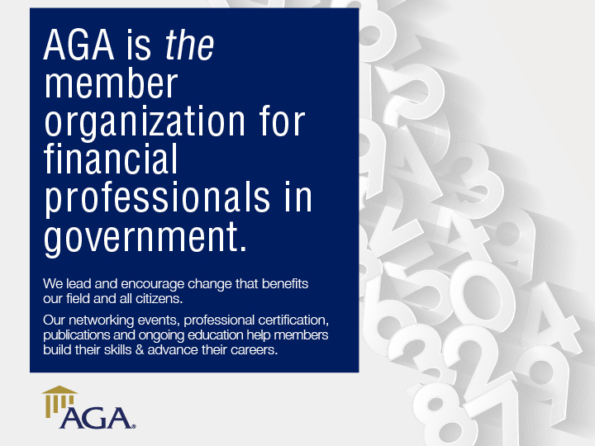
Notes:
Drag Picture and Send to Back

Slide 23

PROFESSIONAL CERTIFICATION
www.agacgfm.org/cgfm
Certified Government Financial Manager® (CGFM®) certification encompasses governmental accounting, auditing, financial reporting, internal controls and budgeting at the federal, state and local levels
Demonstrates achievement of expertise in the field of government financial management
Recognizes the unique skills and special knowledge required of today’s government financial managers
Today, there are approximately 9,900 CGFMs
Notes:
The Certified Government Financial Manager (CGFM) credential includes broad coverages of various aspects of financial management for all levels of government

Slide 24
AGA ETHICS RESOURCES
www.agacgfm.org
  Journal of Government Financial Management:
    Winter Issue: Ethics – Are We Losing Ground?
    Submit an ethics question anytime
  Webinars:
    Dec. 2, 2015
    May 11, 2016
  Group Training:
    Ethics in the Workplace
    Ethical Decision-Making
Notes:
Journal:
Winter Issue (November 2015): Ethics – Are We Losing Ground? Articles highlight what government agencies, private sector entities and academia are doing to strengthen and encourage ethical practices within their organizations.
Submit an ethics question — submit an anonymous question so it may be reviewed and responded to by an expert on ethics. Anonymous questions, and related answers, may be published in the Journal of Government Financial Management and/or other AGA publications.
Webinars:
Ethics related webinars are on December 2 and May 11. Webinars are worth 2 CPE, and cost just $49 for AGA members. Held from 2-3:50 p.m. ET on Wednesdays.
Group Training:
AGA offers a variety of classroom-style courses to meet your staff's training and education needs. These courses can be designed around your particular requirements and are presented at your facility by experienced and knowledgeable financial management professionals. Participants are awarded 8 to 16 CPE hours at the conclusion of each course.

Slide 25


REGISTER TODAY!

Slide 26
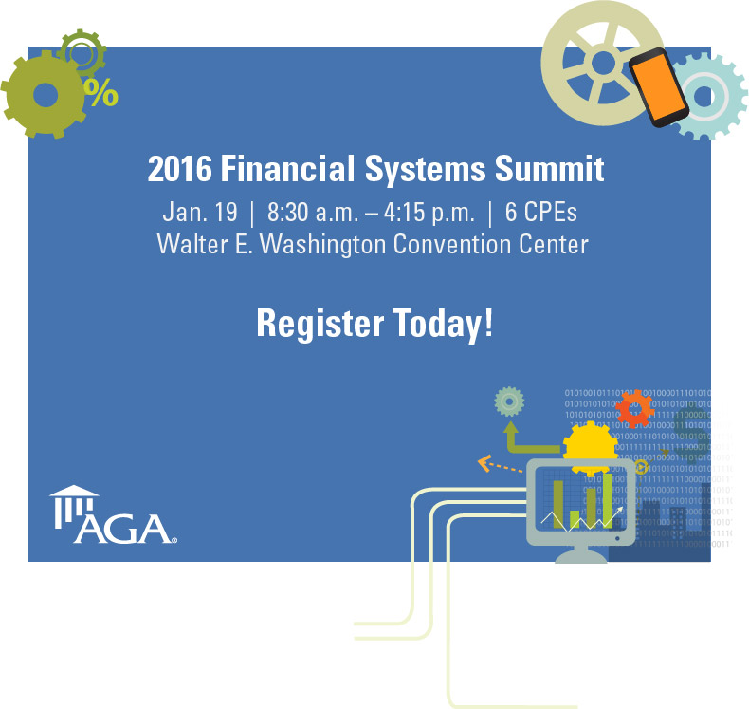

Slide 27
