Slide 1
Data Leveraging
The use of Data Mining and Data Analytics in static and cross-platform environments

Slide 2
Richard Mazzaferro richard.mazzaferro@its.ny.gov
BA New York State University at Albany, American History with Honors
MBA Union Graduate College
Certificate in Management, Rockefeller Institute
Certificate in Management, Cornell School of Industrial and Labor Relations
Graduate of the Public Management Institute, State of New York

Slide 3
Goal of the Presentation
Provide a conceptual framework for the approach to the use of Data
Notes:
The concept of the approach is more important than the details of the moving parts.

Slide 4
Agenda:
Distinctions between Data Mining and Data Analytics
How the two activities relate
Use of these activities on static datasets and in cross platform/multi-data source environments
Q & A

Slide 5
Data Mining
Data Analytics

Slide 6
Data Mining Versus Data Analytics
Data Mining – the activities related to discovering patterns from bodies of data
Data Analytics – the activities related to using the data in context
Notes:
Discuss briefly with audience – solicit one or two ideas.

Slide 7
Types of Data
Operational/Transactional - events
Non-Operational – descriptive
Metadata – data about data
  Descriptive
  Structural
  Administrative

Slide 8
Purpose of Data Mining
Explore the nature of the data itself
Uncover patterns
Identify and learn about relevant cohorts
  Demographics
  Behavior
Verify beliefs about your business

Slide 9

The First Step…
Look at the data!

Slide 10
The Data Mining Process
Acquisition
Review/Pre-Processing
Discovery
Summary
Catalog
Notes:
Acquisition from primary source. Pre-processing involving cleansing, warehousing, and applying security protocols. Mention CRISP-DM - Cross Industry Standard Process for Data Mining

Slide 11
The Data Mining Process – Acquisition
What is the source?
How is the data defined by the owners?
Interview the owners about the data
  How do they understand the data?
  What is the format?
  One time extract or continuous feed?
    Schedule for remittance?
  How will the data be transmitted?
Are there restrictions or conditions for use?
Notes:
Federal data from some agencies requires specific storage, places conditions on comingling, and mandates specific logging of use.

Slide 12

Garbage in, garbage out!

Slide 13
Use Case: Federal Information Return Files
https://www.irs.gov/pub/irs-pdf/p1220.pdf

Slide 14
The Data Mining Process-Review/Pre-Processing
Has the nature of the data been specifically identified?
What is the intended use of the data in mechanical terms?
    Use as a static set or used in the context of other data?
Is the data in a usable format?
Cleansing
    Unwanted characters, default placeholders/fillers, duplicate records
Formatting
    Primary Key
    Dates, numeric and character values
Storage
  Data Mart vs Data Warehouse
Notes:
Site the example of data from ORPS/assessors – virtually unusable

Slide 15
The Data Mining Process - Discovery
Is the data iterative?
Does the data imply strata?
What is the distribution of the cohort(s) within the sample?

Slide 16
The Data Mining Process – Discovery
Binning
  ‘Bucketing’ data points into groups of intervals
    E.G. Grouping people by age into age ranges
Determine the type of distribution
  Symmetrical
  Skewed
Stratification and Cohorts

Slide 17
Why Knowing the Distribution Type Matters
Indicates the nature of the sample
Should the sample be cohorted? Binned?
May influence the type of regression model used
  Modeling the mean or the median?
Notes:
Example – analysis of billionaires and minimum wage earners. OLS regression models the mean.

Slide 18
Normal Distribution: Household Income, 2012 https://factfinder.census.gov/faces/tableservices/jsf/pages/productview.xhtml?pid=ACS_15_5YR_DP03&src=pt
Notes:
Example of a normal, symmetrical distribution

Slide 19
Data Analysis Tools in MS Excel
Where is the data analysis tool in Excel?
Click the File tab, click Options, and then click the Add-Ins category. In the Manage box, select Excel Add-ins and then click Go. In the Add-Ins available box, select the Analysis ToolPak check box, and then click OK

Slide 20
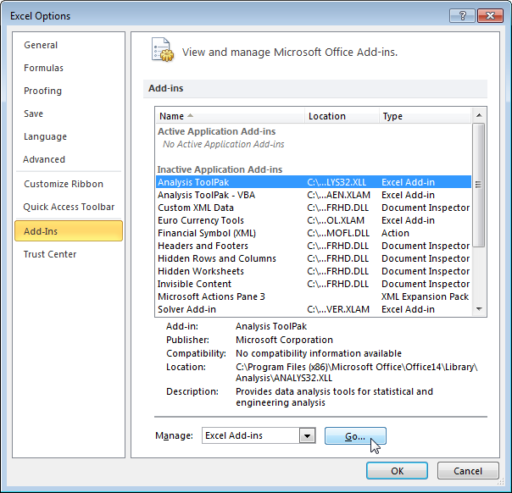
Data Analysis Tools in MS Excel

Slide 21
Use Case: Retail Sales for 2007; Data Mining using Microsoft Excel

Slide 22
Retail Sales for 2007
Data Selection Criteria
NAICS Code beginning ’44’
Year = 2007
Sales greater than 0
No upper limit on Sales
Binning
  Sample bucketed into 20 equal bins

Slide 23
Retail Sales for 2007

Slide 24
Retail Sales for 2007

Slide 25
Retail Sales for 2007
Sales < $10,000,000

Slide 26
Summary
What was learned
  What attributes will drive the approaches for analysis?
  What hypothesis were verified? Refuted?
Does the data say what was expected?
Notes:
The sample had to be cohorted.

Slide 27
Catalog
Provide locations and descriptions for future use
Methods
  Institute intranet
  COGNOS
  Socrata or other open data environments

Slide 28
Data Analytics
Predictive and Outlier detection
  Regression modeling
Identification of relationships
  Association modeling using visual intelligence

Slide 29
Measures of Central Tendency
Mean
Median
Mode

Slide 30
Mean
The mean is the sum of all values in a set divided by the number of values.
Example:
  A set contains the following
  3, 4, 7, 12, 6, 9, 15
  The sum = 56, which divided by 7 = 8
  8 = the mean
Outliers can have a powerful affect on the mean and can create misleading results. In the example above, if 12 were replaced with 200, the mean would be 34.86 and not representative of our population.

Slide 31
Median
The median is the middle value of a set of numbers arranged in ascending order.
  If there is an odd number of values, the median is the middle value.
  Given: 1, 3, 3, 6, 7, 8, 9
  The median = 6
  If there are an even number of values, the median equals the mean of the two middle values.
  Given: 1, 2, 3, 4, 5, 6, 8, 9
  The median = (4+5)/2 = 4.5
  The median is less affected by outliers.

Slide 32
Mode
The value that occurs most frequently in a set of values.
  Given: 12, 23, 35, 41, 41, 41, 56, 62, 62, 70, 95
  The mode = 41
  The mode is typically not affected by outliers.

Slide 33
Measures of Central Tendency – application
Mean – when the data is normally distributed
Median – when the distribution is skewed
  E.G. analysis of salaries in a plant where workers earn between $20 – 30k and one boss earns $150k
  Workers: $20, 20, 22, 22, 24, 24, 25, 27, 28, 30k
  Boss: $150k
  Mean = $35.64k
  Median = $24k
Mode – most popular flavor of ice cream based on sales

Slide 34
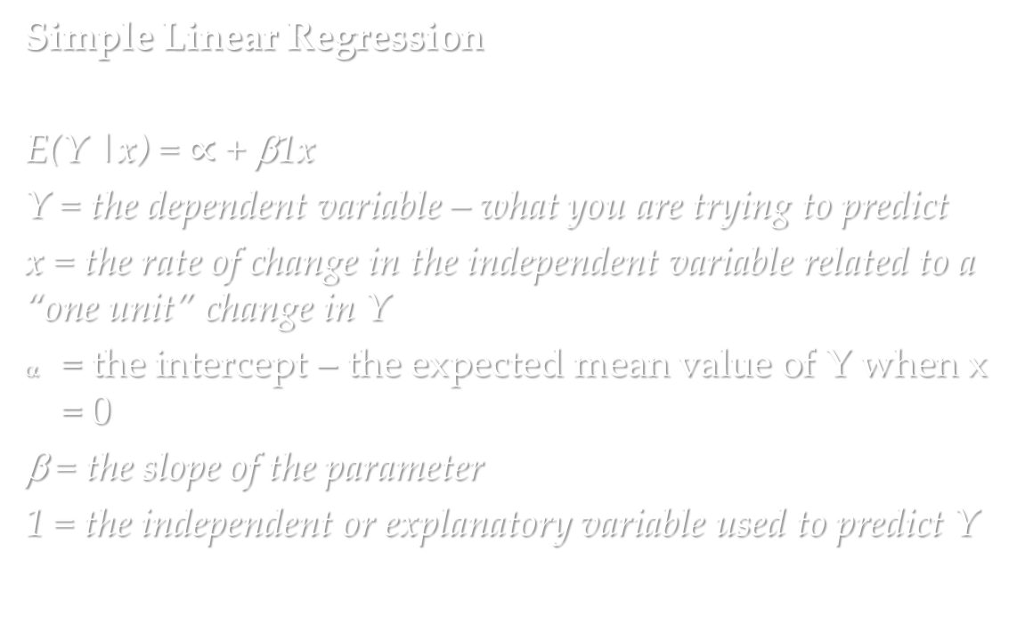
Retail Sales for 2007
Simple Linear Regression
E(Y |x) = $∝$ + β1x
Y = the dependent variable – what you are trying to predict
x = the rate of change in the independent variable related to a “one unit” change in Y
= the intercept – the expected mean value of Y when x = 0
β = the slope of the parameter
1 = the independent or explanatory variable used to predict Y
Notes:
Back to our use case…

Slide 35
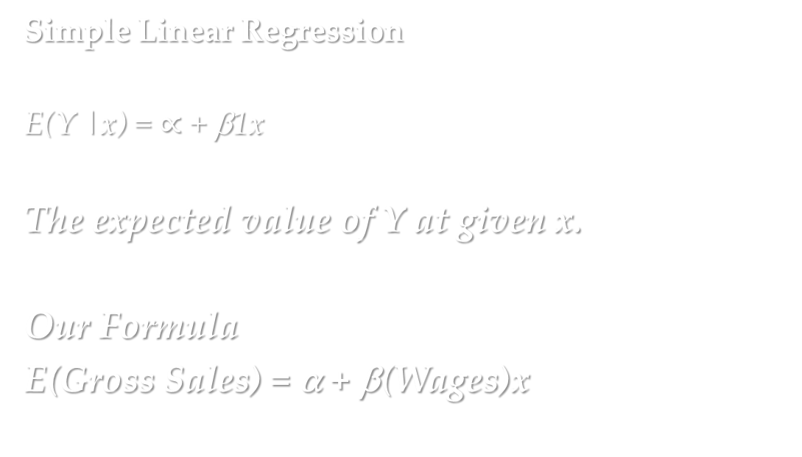
Retail Sales for 2007
Simple Linear Regression
E(Y |x) = $∝$ + β1x
The expected value of Y at given x.
Our Formula
E(Gross Sales) = α + β(Wages)x

Slide 36
Retail Sales for 2007
Sales < $10,000,000

Slide 37
Retail Sales for 2007

Slide 38
Retail Sales for 2007
Fit of the Model
F Value = 92.89
  Test of the null hypothesis – essentially that X has no effect on Y
R-squared = 0.6817
  The percent of variation in the dependent variables explained by the variation in the independent variables
  How closely the data are fitted with the regression line
Parameter estimates
  Coefficient = 6.98
    For every $1 increase in wages, we have a $6.98 increase in gross sales
Notes:
Others: t Value = difference between hypothesized mean and a population value mean, or whether a coefficient is significantly different than zero.

Slide 39
Identification of relationships
  Association modeling using visual intelligence
    Use of Non-Operational/Descriptive Data
      Addresses
      Phone Numbers
      Unique ID numbers

Slide 40
Association Modeling using i2
About i2
  Founded in 1990 in Cambridge, UK
  Used by military intelligence, law enforcement, and commercial agencies
  Acquired by IBM in 2011 and integrated into the Identity Insights suite of products
What i2 does
  Creates visual charts
    Relationships between entities
    Relationships between events

Slide 41
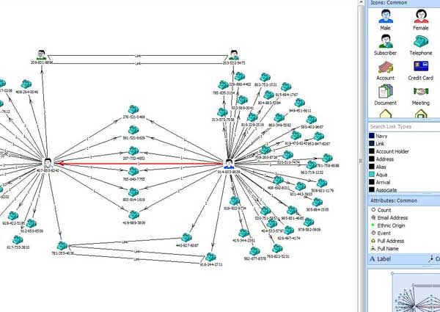
Association Modeling using i2 – association chart

Slide 42
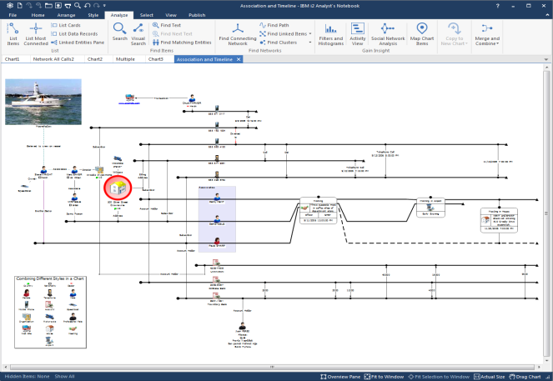
Association Modeling using i2 – timeline chart

Slide 43
Choosing the Right Tools
Statistical Analysis System (SAS)
  Originally designed for statisticians
  Now has more than 200 components
  Capable of cross-platform querying and writing to multiple environments including DB2
  Powerful graphical components
  Mapping technology

Slide 44
Other Tools
JMP
Excel
i2
COGNOS
AQT
SPSS

Slide 45
Data Leveraging
Data Mining
Data Analytics
Data Knowledge Application

Slide 46

We may know what we are looking for, but can’t always know what we will find.

